Slide 1
Linear Regression
Chapter 7

Slide 2
Introduction (Slide 1 of 2)
Managerial decisions are often based on the relationship between two or more variables:
Example: After considering the relationship between advertising expenditures and sales, a marketing manager might attempt to predict sales for a given level of advertising expenditures.
Sometimes a manager will rely on intuition to judge how two variables are related.
If data can be obtained, a statistical procedure called regression analysis can be used to develop an equation showing how the variables are related.

Slide 3
Introduction (Slide 2 of 2)
Dependent variable or response: Variable being predicted.
Independent variables or predictor variables: Variables being used to predict the value of the dependent variable.
Simple linear regression: A regression analysis for which any one unit change in the independent variable, x, is assumed to result in the same change in the dependent variable, y.
Multiple linear regression: A regression analysis involving two or more independent variables.

Slide 4
Simple Linear Regression Model
Regression Model
Estimated Regression Equation

Slide 5
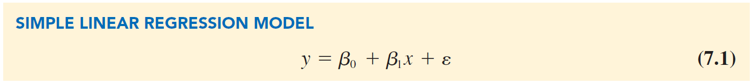
Simple Linear Regression Model (Slide 1 of 5)
Regression Model:
The equation that describes how y is related to x and an error term.
Parameters: The characteristics of the population,
Random variable: Error term,
The error term accounts for the variability in y that cannot be explained by the linear relationship between x and y.
Notes:
In the Butler Trucking Company example, the population consists of all the driving assignments that can be made by the company.
For every driving assignment in the population, there is a value of x (miles traveled) and a corresponding value of y (travel time in hours).

Slide 6
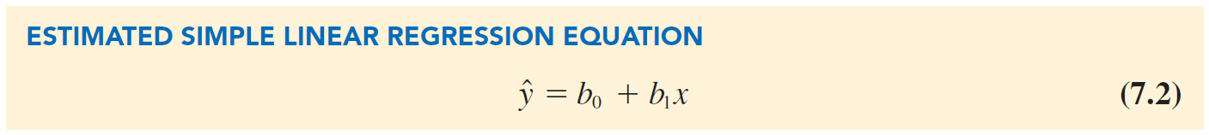
Simple Linear Regression Model (Slide 2 of 5)
Estimated Regression Equation:
The parameter values are usually not known and must be estimated using sample data.
Sample statistics
are computed as estimates of the population parameters
Substituting the values of the sample statistics
the regression equation and dropping the error term, we obtain the estimated regression for simple linear regression.
Notes:
To estimate the mean or expected value of travel time for a driving assignment of 75 miles, Butler Trucking would substitute the value of 75 for x in equation $\hat{y}$ = b₀ + b₁x.

Slide 7
Simple Linear Regression Model (Slide 3 of 5)
In the estimated simple linear regression equation:
Estimate for the mean value of y corresponding to a given value of x.
Estimated y-intercept.
Estimated slope.
The graph of the estimated simple linear regression equation is called the estimated regression line.
In general,
the mean value of y for a given value of x.
is the point estimator of
Notes:
To estimate the mean or expected value of travel time for a driving assignment of 75 miles, Butler Trucking would substitute the value of 75 for x in equation $\hat{y}$ = b₀ + b₁x.

Slide 8
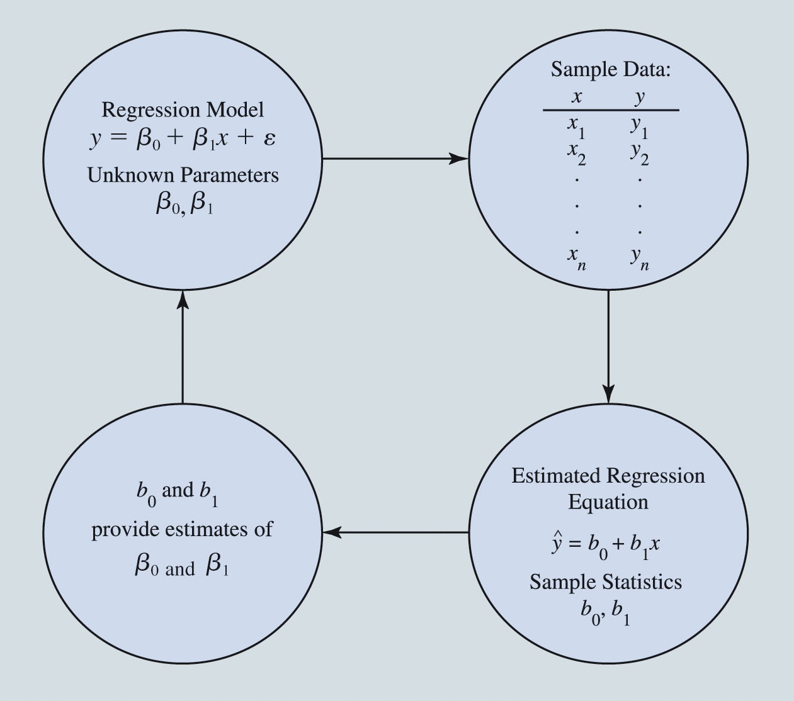
Simple Linear Regression Model (Slide 4 of 5)
Figure 7.1: The Estimation Process in Simple Linear Regression

Slide 9
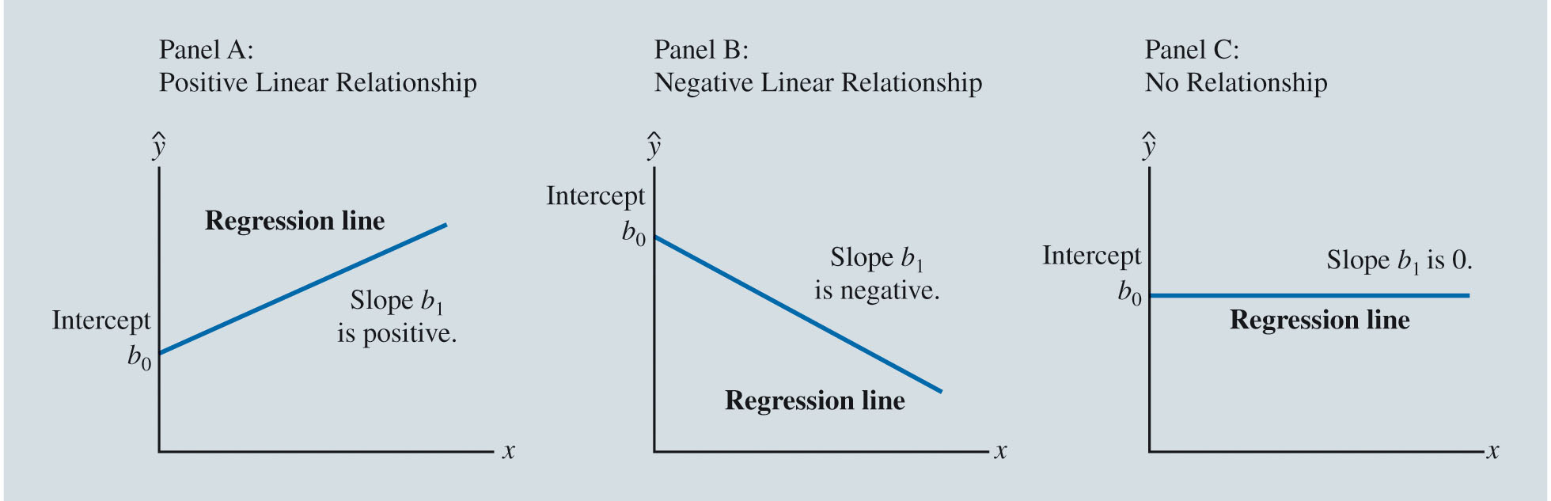
Simple Linear Regression Model (Slide 5 of 5)
Figure 7.2: Possible Regression Lines in Simple Linear Regression
Notes:
The regression line in Panel A shows that the mean value of y is related positively to x, with larger values of $\hat{y}$ associated with larger values of x.
In Panel B, the mean value of y is related negatively to x, with smaller values of $\hat{y}$ associated with larger values of x.
In Panel C, the mean value of y is not related to x; that is, $\hat{y}$ is the same for every value of x.

Slide 10
Least Squares Method
Least Squares Estimates of the Regression Parameters
Using Excel’s Chart Tools to Compute the Estimated Regression Equation

Slide 11
Least Squares Method (Slide 1 of 15)
Least squares method: A procedure for using sample data to find the estimated regression equation.
Determine the values of
Interpretation of
is the estimated change in the mean of the dependent variable y that is associated with a one unit increase in the independent variable x.
The y-intercept
The slope
is the estimated value of the dependent variable y when the independent variable x is equal to 0.

Slide 12
Least Squares Method (Slide 2 of 15)
Table 7.1: Miles Traveled and Travel Time for 10 Butler Trucking Company Driving Assignments
Driving Assignment i | x = Miles Traveled | y = Travel Time (hours)
1 | 100 | 9.3
2 | 50 | 4.8
3 | 50 | 8.9
4 | 100 | 6.5
5 | 50 | 4.2
6 | 80 | 6.2
7 | 75 | 7.4
8 | 65 | 6.0
9 | 90 | 7.6
10 | 90 | 6.1
Notes:
To illustrate the least squares method, suppose data were collected from a sample of 10 Butler Trucking Company driving assignments.
For the ith observation or driving assignment in the sample, x_{i} is the miles traveled and y_{i} is the travel time (in hours).
The values of x_{i} and y_{i} for the 10 driving assignments in the sample are summarized in Table 7.1.

Slide 13
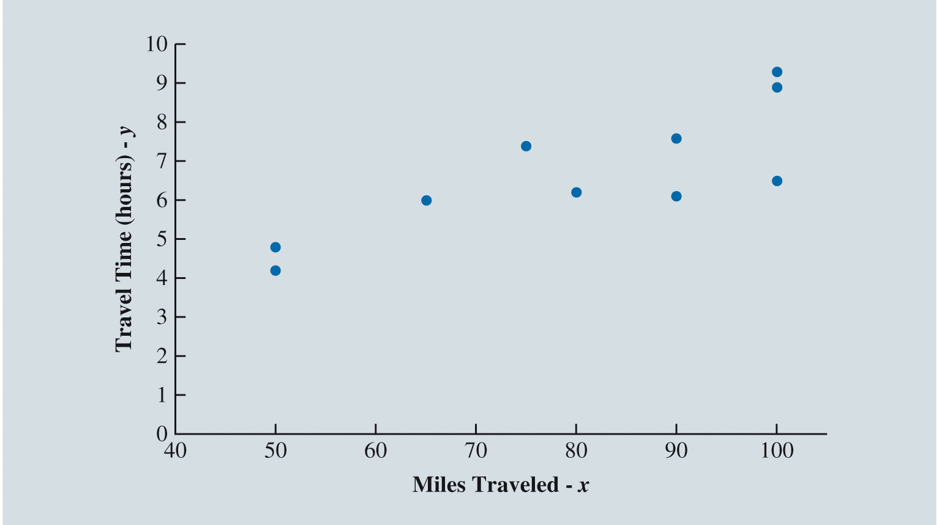
Least Squares Method (Slide 3 of 15)
Figure 7.3: Scatter Chart of Miles Traveled and Travel Time for Sample of 10 Butler Trucking Company Driving Assignments
Notes:
Figure 7.3 is a scatter chart of the data in Table 7.1.
Miles traveled is shown on the horizontal axis, and travel time (in hours) is shown on the vertical axis.
Longer travel times appear to coincide with more miles traveled.
The relationship between the travel time and miles traveled appears to be approximated by a straight line; indeed, a positive linear relationship is indicated between x and y.
Therefore, the simple linear regression model is chosen to represent this relationship.

Slide 14
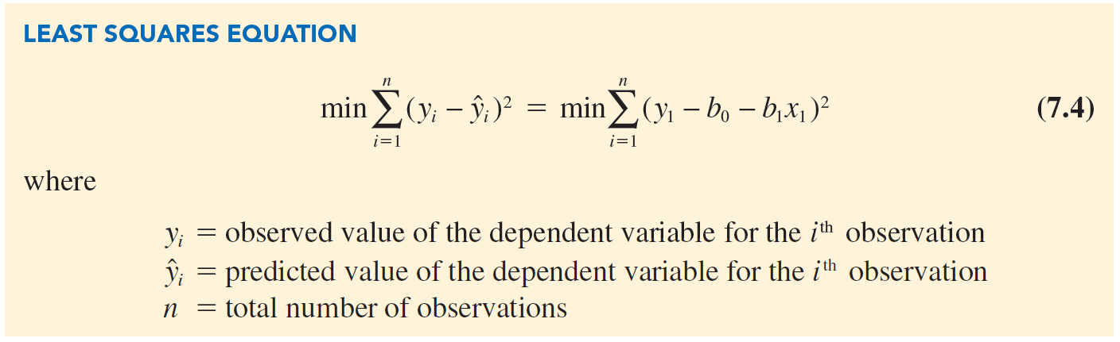
Least Squares Method (Slide 4 of 15)

Slide 15
Least Squares Method (Slide 5 of 15)
residual: The error made using the regression model to estimate the mean value of the dependent variable for the
observation.
Denoted as
Hence,
We are finding the regression that minimizes the sum of squared errors.

Slide 16
Least Squares Method (Slide 6 of 15)
Least Squares Estimates of the Regression Parameters:
For the Butler Trucking Company data in Table 7.1:
Estimated slope of
y-intercept of
The estimated simple linear regression model:

Slide 17
Least Squares Method (Slide 7 of 15)
If the length of a driving assignment were 1 unit (1 mile) longer, the mean travel time for that driving assignment would be 0.0678 units (0.0678 hours, or approximately 4 minutes) longer.
Interpretation of
Interpretation of
If the driving distance for a driving assignment was 0 units (0 miles), the mean travel time would be 1.2739 units (1.2739 hours, or approximately 76 minutes).
Notes:
We interpret b₁ and b₀ as we would the y-intercept and slope of any straight line.

Slide 18
Least Squares Method (Slide 8 of 15)
Experimental region: The range of values of the independent variables in the data used to estimate the model.
The regression model is valid only over this region.
Extrapolation: Prediction of the value of the dependent variable outside the experimental region.
It is risky.
Notes:
Because we have no empirical evidence that the relationship we have found holds true for values of x outside of the range of values of x in the data used to estimate the relationship, extrapolation is risky and should be avoided if possible.
For Butler Trucking, this means that any prediction outside the travel time for a driving distance less than 50 miles or greater than 100 miles is not a reliable estimate, and so for this model the estimate of β₀ is meaningless.
However, if the experimental region for a regression problem includes zero, the y-intercept will have a meaningful interpretation.

Slide 19
Least Squares Method (Slide 9 of 15)
Butler Trucking Company example: Use the estimated model and the known values for miles traveled for a driving assignment (x) to estimate mean travel time in hours.
For example, the first driving assignment in Table 7.1 has a value for miles traveled of
The mean travel time in hours for this driving assignment is estimated to be:
The resulting residual of the estimate is:
Notes:
The simple linear regression model underestimated travel time for this driving assignment by 1.2461 hours (approximately 74 minutes).

Slide 20
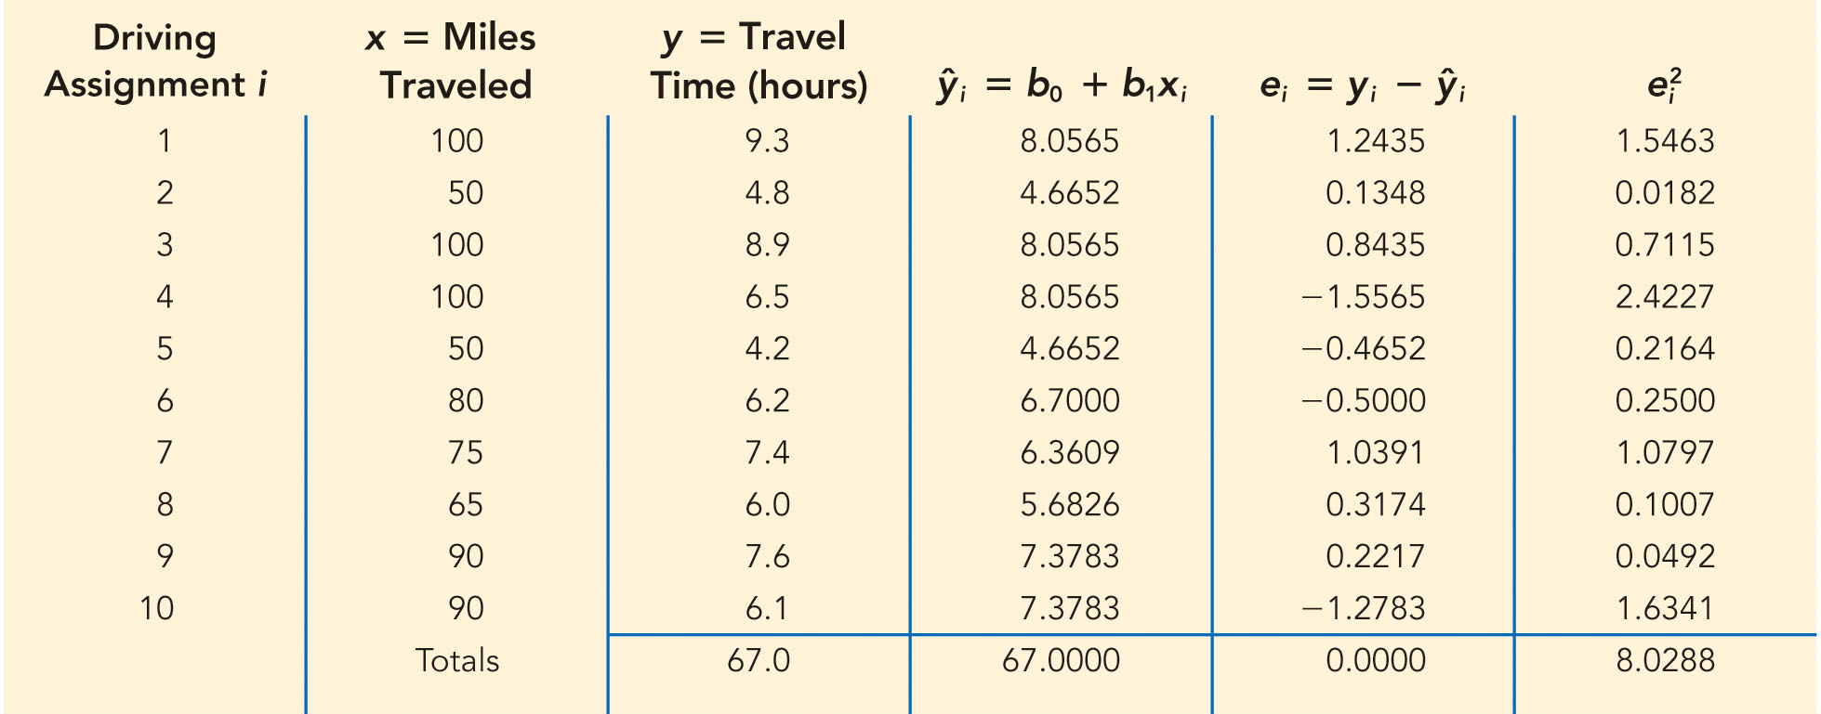
Least Squares Method (Slide 10 of 15)
Table 7.2: Predicted Travel Time and Residuals for 10 Butler Trucking Company Driving Assignments
Notes:
Note in Table 7.2 that:
The sum of predicted values ${\hat{y}}_{i}$ is equal to the sum of the values of the dependent variable y.
The sum of the residuals e_{i} is 0.
The sum of the squared residuals $e_{i}^{2}$ has been minimized.

Slide 21
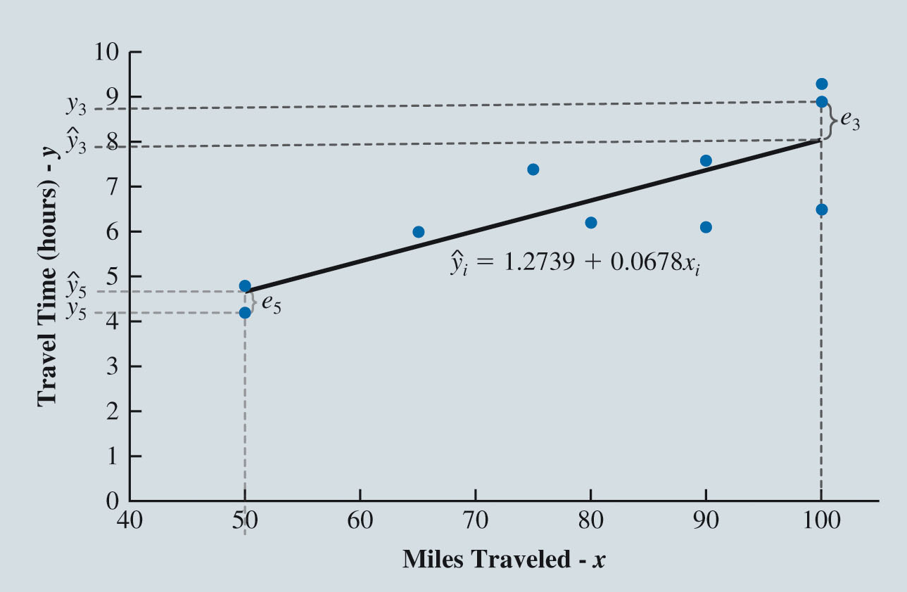
Least Squares Method (Slide 11 of 15)
Figure 7.4: Scatter Chart of Miles Traveled and Travel Time for Butler Trucking Company Driving Assignments with Regression Line Superimposed
Notes:
Figure 7.4 shows the simple linear regression line ${\hat{y}}_{i}$ = 1.2739 + 0.0678x_{i} superimposed on the scatter chart for the Butler Trucking Company data in Table 7.1.
This figure, which also highlights the residuals for driving assignment 3 (e₃) and driving assignment 5 (e₅), shows that the regression model underpredicts travel time for some driving assignments (such as driving assignment 3) and overpredicts travel time for others (such as driving assignment 5), but in general appears to fit the data relatively well.

Slide 22
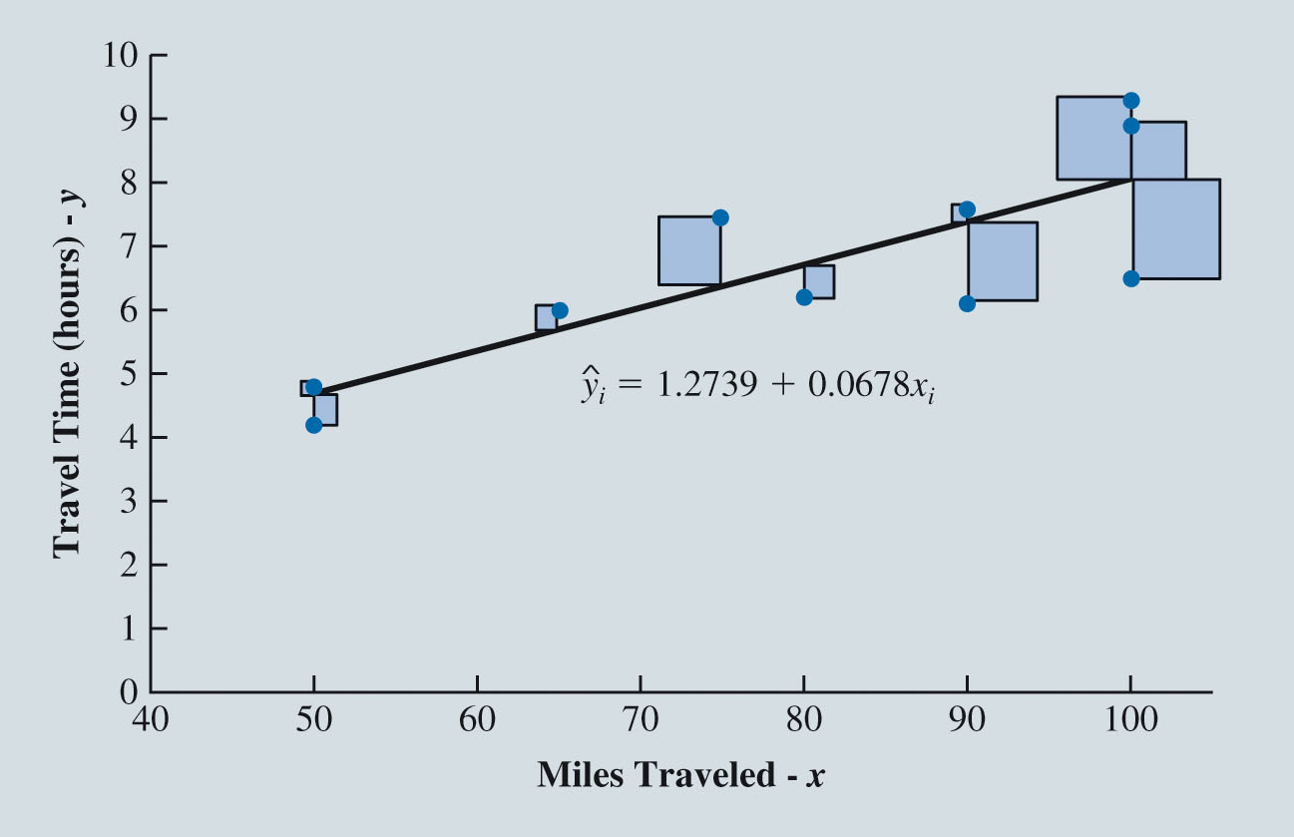
Least Squares Method (Slide 12 of 15)
Figure 7.5: A Geometric Interpretation of the Least Squares Method
Notes:
In Figure 7.5, a vertical line is drawn from each point in the scatter chart to the linear regression line.
Each of these lines represents the difference between the actual driving time and the driving time to be predicted using linear regression for one of the assignments in the data.
The length of each line is equal to the absolute value of the residual for one of the driving assignments.
When a residual is squared, the resulting value is equal to the square that is formed using the vertical dashed line representing the residual in Figure 7.4 as one side of a square.
Thus, when we find the linear regression model that minimizes the sum of squared errors for the Butler Trucking example, we are positioning the regression line in the manner that minimizes the sum of the areas of the ten squares in Figure 7.5.

Slide 23
Least Squares Method (Slide 13 of 15)
Using Excel’s Chart Tools to Compute the Estimated Regression Equation:
After constructing a scatter chart with Excel’s chart tools:
Right-click on any data point and select Add Trendline.
In the Format Trendline task pane, in the Trendline Options area:
Select Linear.
Select Display Equation on chart.

Slide 24
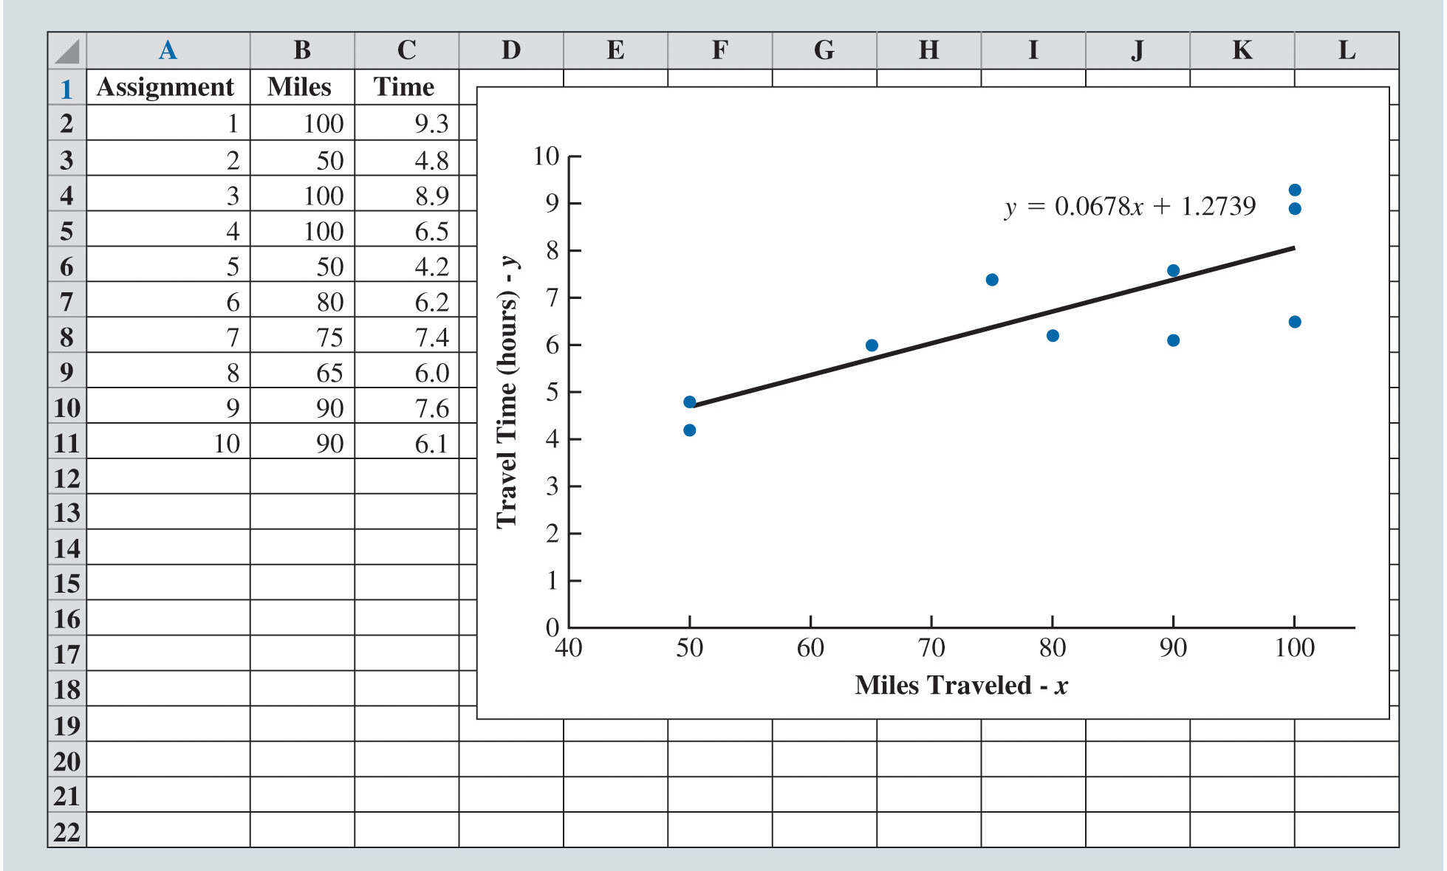
Least Squares Method (Slide 14 of 15)
Figure 7.6: Scatter Chart and Estimated Regression Line for Butler Trucking Company
Notes:
We can use Excel’s chart tools to compute the estimated regression equation on a scatter chart of the Butler Trucking Company data in Table 7.1.
After constructing a scatter chart (as shown in Figure 7.3) with Excel’s chart tools, the following steps describe how to compute the estimated regression equation using the data in the worksheet:
Step 1. Right-click on any data point in the scatter chart and select Add Trendline
Step 2. When the Format Trendline task pane appears:
Select Linear in the Trendline Options area
Select Display Equation on chart in the Trendline Options area
The worksheet displayed in Figure 7.6 shows the original data, scatter chart, estimated regression line, and estimated regression equation.
Note that Excel uses y instead of $\hat{y}$ to denote the predicted value of the dependent variable and puts the regression equation into slope-intercept form whereas we use the intercept-slope form that is standard in statistics.

Slide 25
Least Squares Method (Slide 15 of 15)
Slope Equation
y-Intercept Equation

Slide 26
Assessing the Fit of the Simple Linear Regression Model
The Sums of Squares
The Coefficient of Determination
Using Excel’s Chart Tools to Compute the Coefficient of Determination

Slide 27
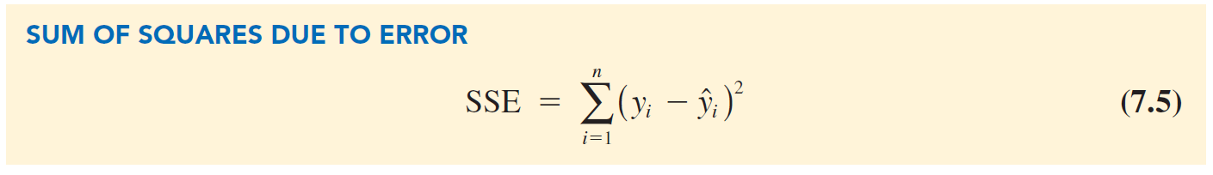
Assessing the Fit of the Simple Linear Regression Model (Slide 1 of 10)
The Sums of Squares:
Sum of squares due to error: The value of SSE is a measure of the error in using the estimated regression equation to predict the values of the dependent variable in the sample.
From Table 7.2,

Slide 28
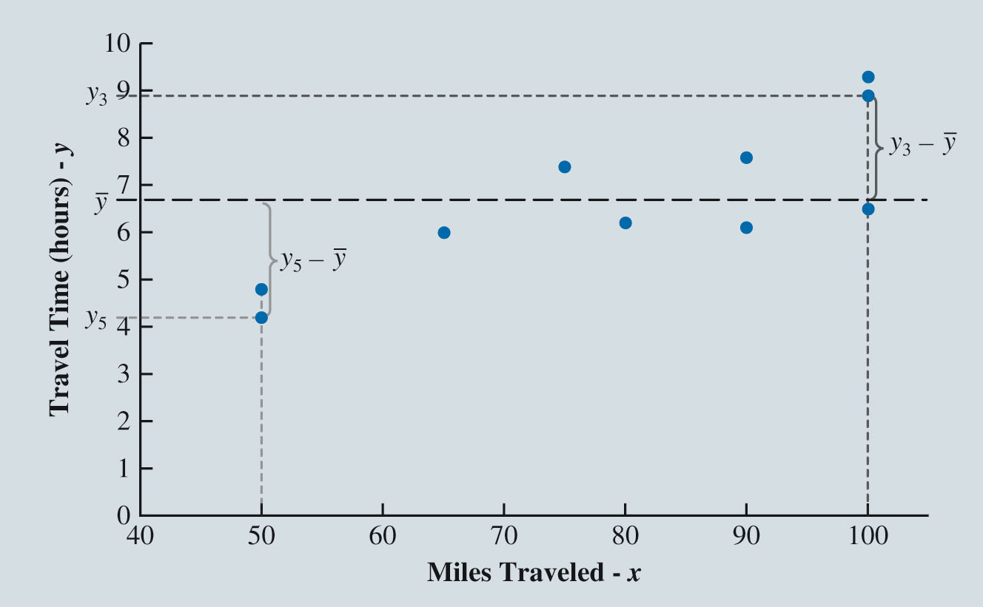
Assessing the Fit of the Simple Linear Regression Model (Slide 2 of 10)
Figure 7.7: The Sample Mean
as a Predictor of Travel Time for Butler Trucking Company
Notes:
Without knowledge of any related variables, we would use the sample mean $\overline{y}$ as a predictor of travel time for any given driving assignment.
To find $\overline{y}$, we divide the sum of the actual driving times y_{i} from Table 7.2 (67) by the number of observations n in the data (10); this yields $\overline{y}$ = 6.7.
Figure 7.7 provides insight on how well we would predict the values of y_{i} in the Butler Trucking company example using $\overline{y}$ = 6.7.
From this figure, which again highlights the residuals for driving assignments 3 and 5, we can see that $\overline{y}$ tends to overpredict travel times for driving assignments that have relatively small values for miles traveled (such as driving assignment 5) and tends to underpredict travel times for driving assignments that have relatively large values for miles traveled (such as driving assignment 3).

Slide 29
Assessing the Fit of the Simple Linear Regression Model (Slide 3 of 10)
Table 7.3 shows the sum of squared deviations obtained by using the sample mean
to predict the value of travel time in hours for each driving assignment in the sample.
Butler Trucking Example: For the
driving assignment in the sample, the difference
provides a measure of the error involved in using
to predict travel time for the
driving assignment.
Notes:
SST is a measure of how well the observations cluster about the $\overline{y}$ line.

Slide 30
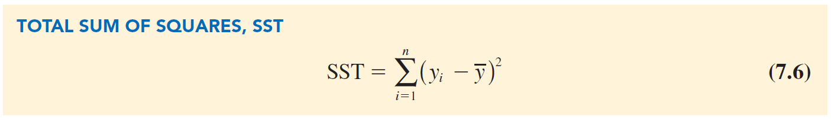
Assessing the Fit of the Simple Linear Regression Model (Slide 4 of 10)
The corresponding sum of squares is called the total sum of squares (SST).
Notes:
SST is a measure of how well the observations cluster about the $\overline{y}$ line.

Slide 31
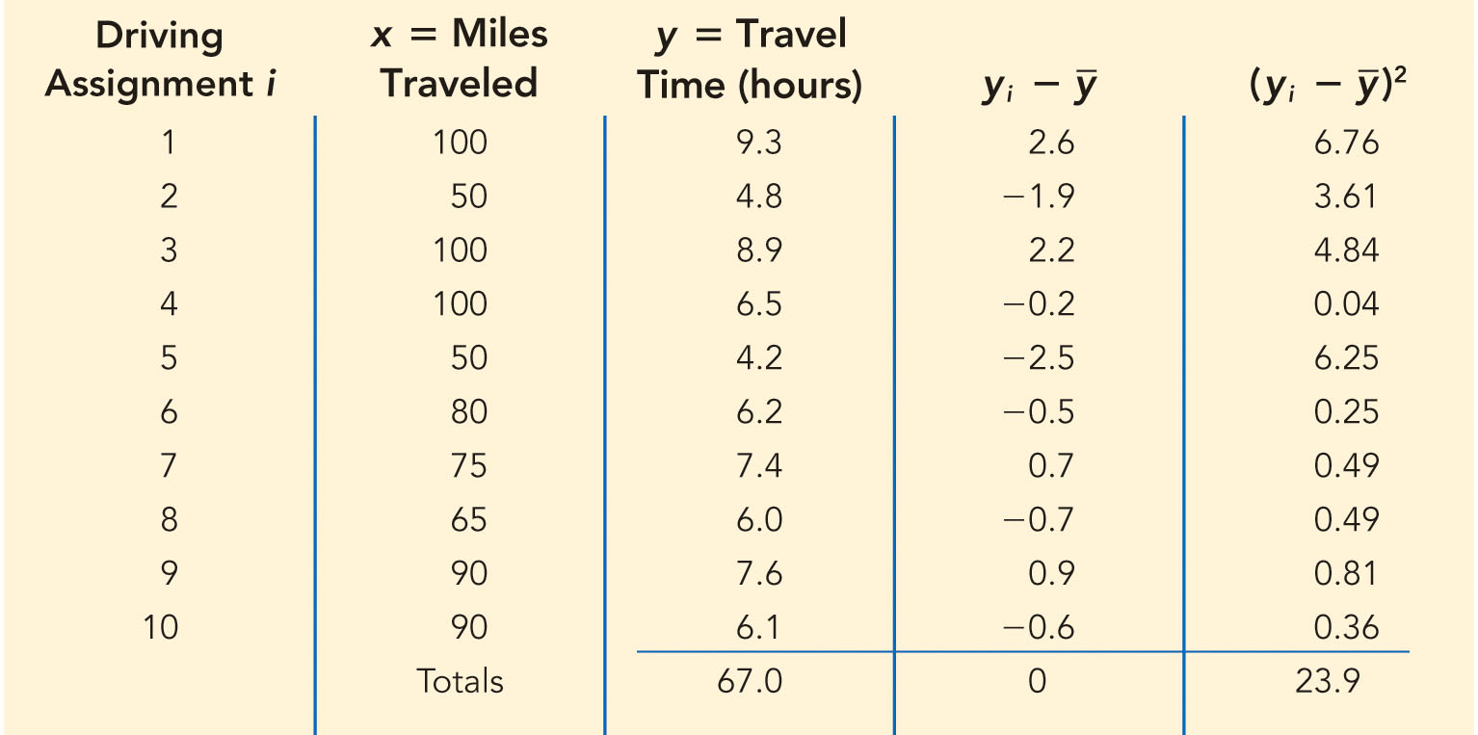
Assessing the Fit of the Simple Linear Regression Model (Slide 5 of 10)
Table 7.3: Calculations for the Sum of Squares Total for the Butler Trucking Simple Linear Regression
Notes:
The sum at the bottom of the last column in Table 7.3 is the total sum of squares for Butler Trucking Company: SST = 23.9.

Slide 32
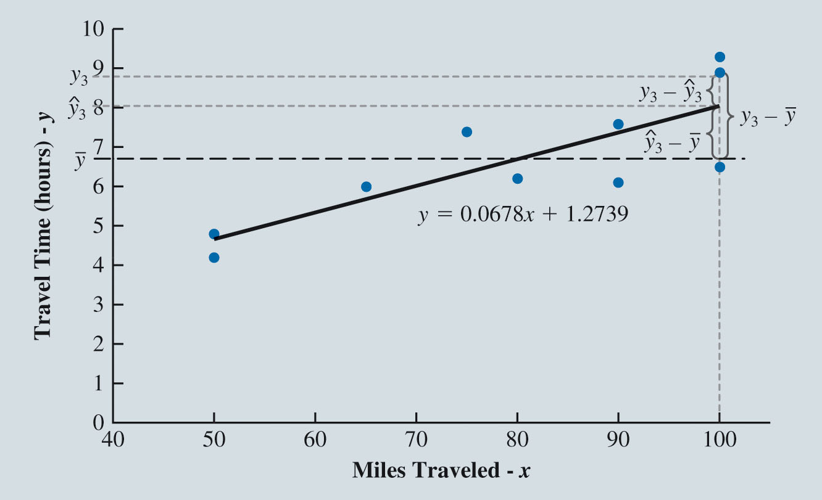
Assessing the Fit of the Simple Linear Regression Model (Slide 6 of 10)
Figure 7.8: Deviations About the Estimated Regression Line and the Line
for the Third Butler Trucking Company Driving Assignment
Notes:
In Figure 7.8, we show the estimated regression line ${\hat{y}}_{i}$ = 1.2739 + 0.0678x_{i} and the line corresponding to $\overline{y}$ = 6.7.
Note that the points cluster more closely around the estimated regression line ${\hat{y}}_{i}$ = 1.2739 + 0.0678x_{i} than they do about the horizontal line $\overline{y}$ = 6.7.

Slide 33
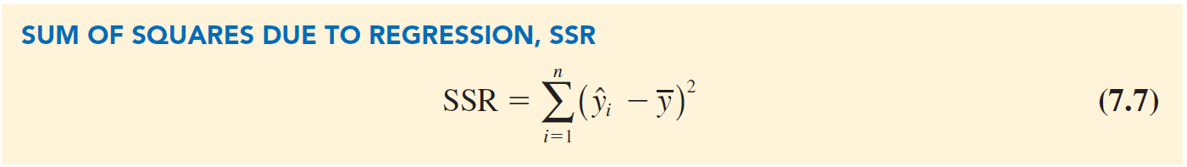
Assessing the Fit of the Simple Linear Regression Model (Slide 7 of 10)
values on the estimated regression line deviate from
Measures how much the
Relation between SST, SSR, and SSE:
where
SST = total sum of squares
SSR = sum of squares due to regression
SSE = sum of squares due to error.
Notes:
In the Butler Trucking Company example, SSE = 8.0288 and SST = 23.9:
SSR = SST $−$ SSE = 23.9 $−$ 8.0288 = 15.8712

Slide 34
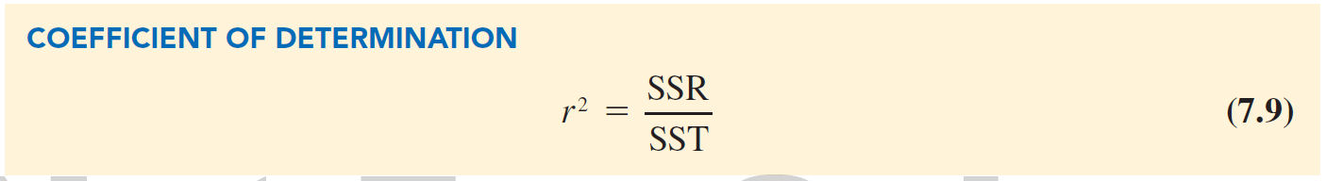
Assessing the Fit of the Simple Linear Regression Model (Slide 8 of 10)
The Coefficient of Determination:
The ratio SSR/SST used to evaluate the goodness of fit for the estimated regression equation; this ratio is called the coefficient of determination and is denoted by
Take values between zero and one.
Interpreted as the percentage of the total sum of squares that can be explained by using the estimated regression equation.
Notes:
For the Butler Trucking Company example, the coefficient of determination,
r² = $\frac{SSR}{SST}$= $\frac{\text{15.8712 }}{\text{23.9 }}$ = 0.6641.
It can be concluded that 66.41% of the total sum of squares can be explained by using the estimated regression equation ${\hat{y}}_{i}$ = 1.2739 + 0.0678x_{i} to predict quarterly sales.

Slide 35
Assessing the Fit of the Simple Linear Regression Model (Slide 9 of 10)
Using Excel’s Chart Tools to Compute the Coefficient of Determination:
To compute the coefficient of determination using the scatter chart in Figure 7.3:
Right-click on any data point in the scatter chart and select Add Trendline.
When the Format Trendline task pane appears: Select Display R-squared value on chart in the Trendline Options area.

Slide 36
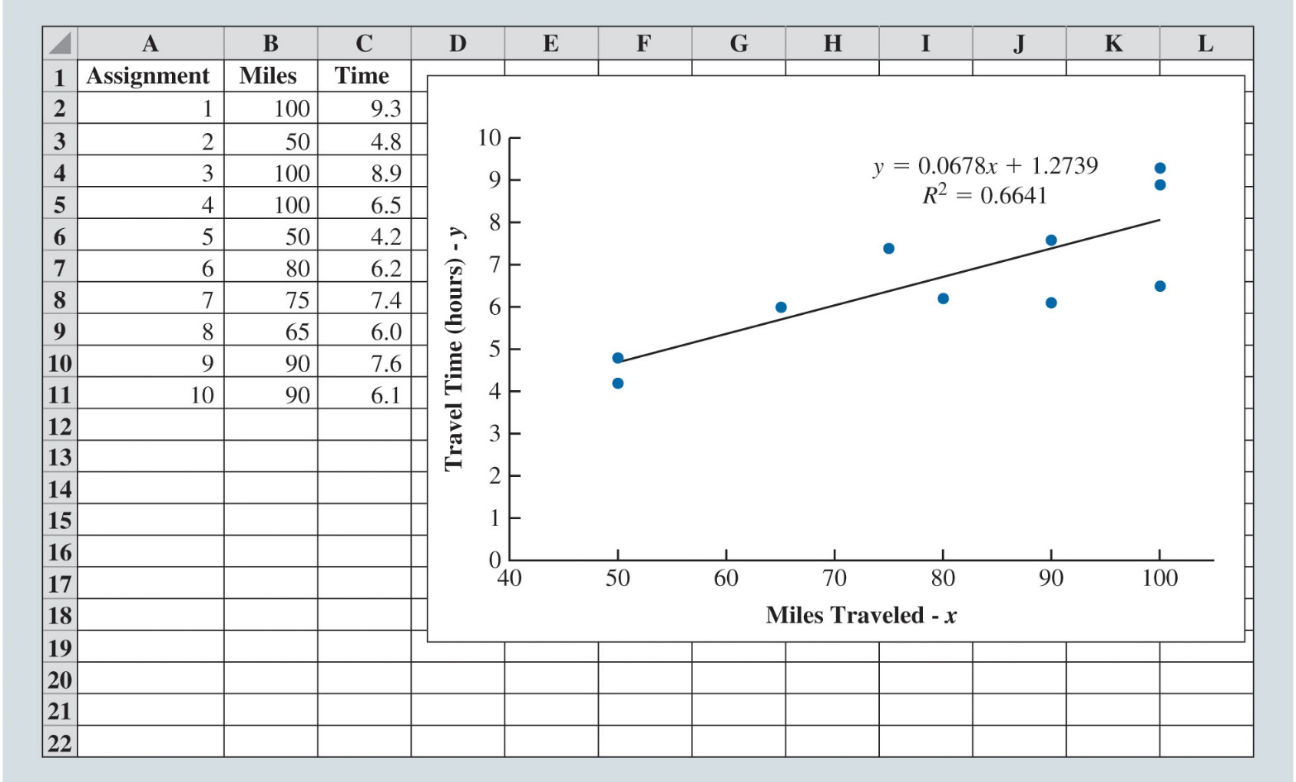
Assessing the Fit of the Simple Linear Regression Model (Slide 10 of 10)
Figure 7.9: Scatter Chart and Estimated Regression Line with Coefficient of Determination
for Butler Trucking Company
Notes:
To compute the coefficient of determination using the scatter chart in Figure 7.3.
Step 1. Right-click on any data point in the scatter chart and select Add Trendline
Step 2. When the Format Trendline task pane appears:
Select Display R-squared value on chart in the Trendline Options area
Figure 7.9 displays the scatter chart, the estimated regression equation, the graph of the estimated regression equation, and the coefficient of determination for the Butler Trucking Company data. We see that r² = 0.6641.

Slide 37
The Multiple Regression Model
Regression Model
Estimated Multiple Regression Equation
Least Squares Method and Multiple Regression
Butler Trucking Company and Multiple Regression
Using Excel’s Regression Tool to Develop the Estimated Multiple Regression Equation

Slide 38
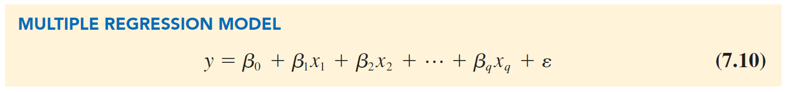
The Multiple Regression Model (Slide 1 of 11)
Regression Model:
y = dependent variable.
= independent variables.
= parameters.
= error term (accounts for the variability in y that cannot be explained by the linear effect of the q independent variables).

Slide 39
The Multiple Regression Model (Slide 2 of 11)
Regression Model (cont.):
Interpretation of slope coefficient
Represents the change in the mean value of the dependent variable y that corresponds to a one unit increase in the independent variable
holding the values of all other independent variables in the model constant.
The multiple regression equation that describes how the mean value of y is related to

Slide 40
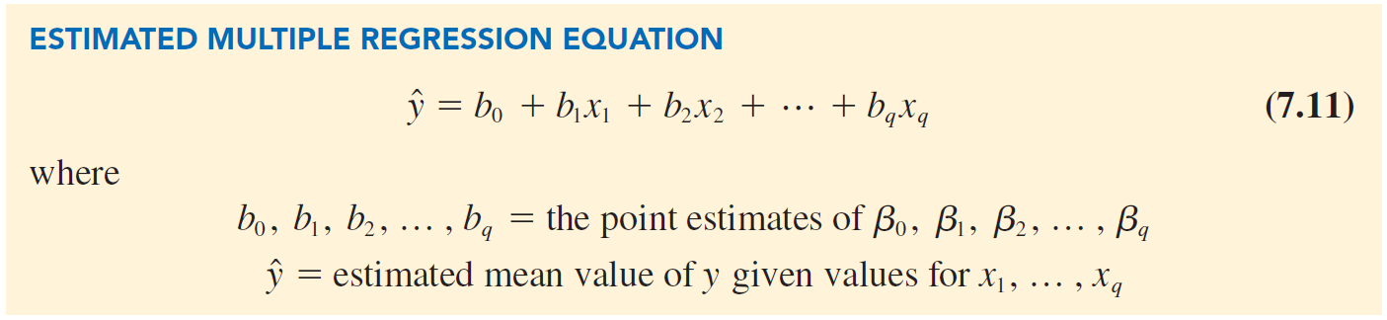
The Multiple Regression Model (Slide 3 of 11)
Estimated Multiple Regression Equation:

Slide 41
The Multiple Regression Model (Slide 4 of 11)
Least Squares Method and Multiple Regression:
The least squares method is used to develop the estimated multiple regression equation:
Finding
Uses sample data to provide the values of
that minimize the sum of squared residuals.

Slide 42
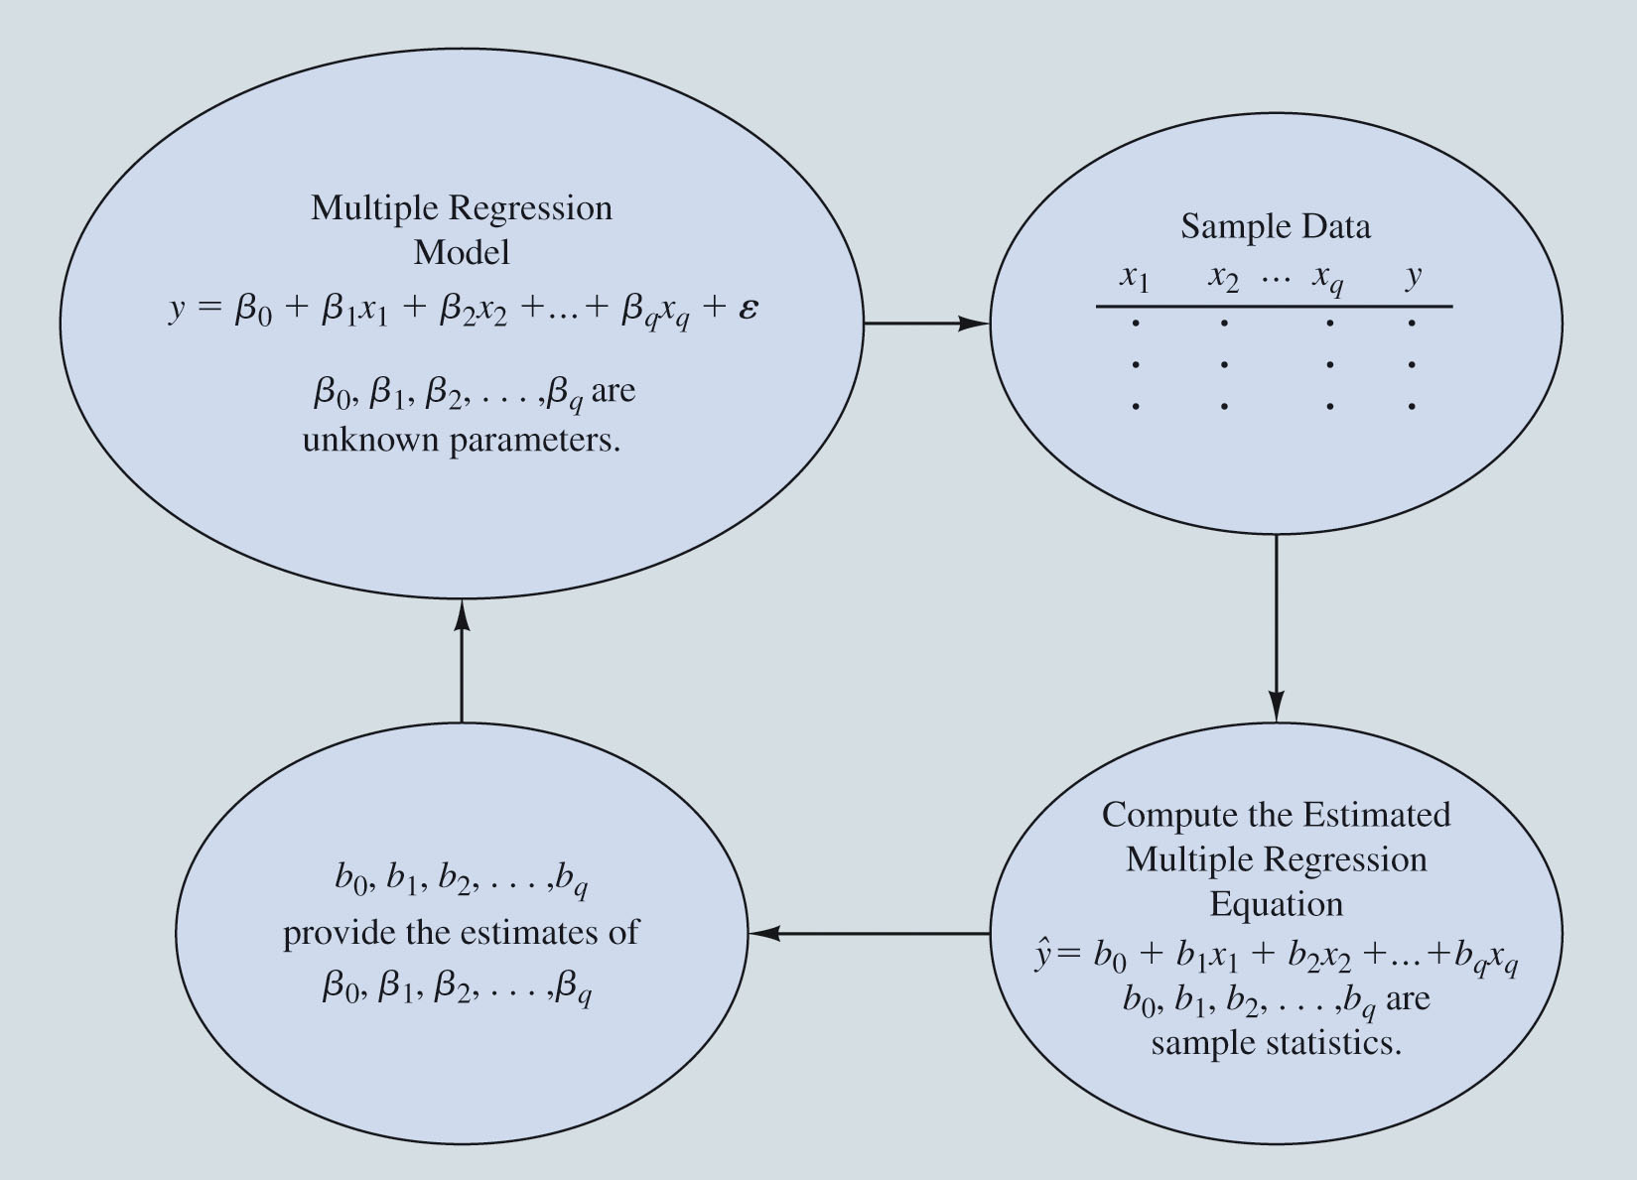
The Multiple Regression Model (Slide 5 of 11)
Figure 7:10: The Estimation Process for Multiple Regression
Notes:
The estimation process for multiple regression is shown in Figure 7.10.
The estimated values of the dependent variable y are computed by substituting values of the independent variables x₁, x₂, . . . , x_{q} into the estimated multiple regression equation.
Computer software packages can be used to obtain the estimated regression equation and determine the regression coefficients b₀, b₁, b₂, . . . , b_{q}.

Slide 43
The Multiple Regression Model (Slide 6 of 11)
Butler Trucking Company and Multiple Regression:
The estimated simple linear regression equation,
The linear effect of the number of miles traveled explains 66.41%
of the variability in travel time in the sample data.
This implies, 33.59% of the variability in sample travel times remains unexplained
The managers might want to consider adding one or more independent variables, such as number of deliveries, to the model to explain some of the remaining variability in the dependent variable.

Slide 44
The Multiple Regression Model (Slide 7 of 11)
Butler Trucking Company and Multiple Regression (cont.):
Estimated multiple linear regression with two independent variables:
Estimated mean travel time.
Distance traveled.
Number of deliveries.
The SST, SSR, SSE and
are computed using the formulas discussed earlier.

Slide 45
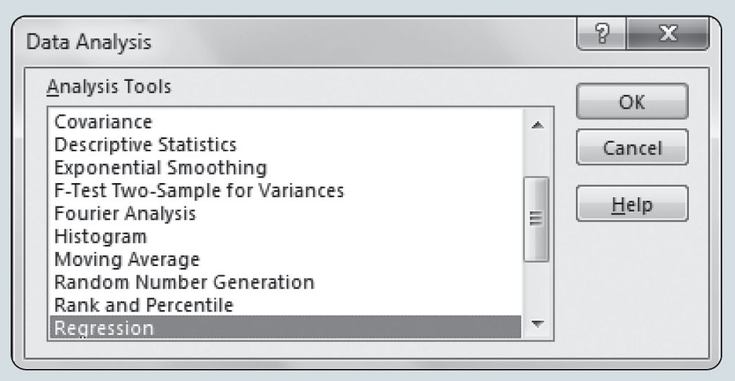
The Multiple Regression Model (Slide 8 of 11)
Using Excel’s Regression Tool to Develop the Estimated Multiple Regression Equation:
Figure 7.11: Data Analysis Tools Box
Notes:
The following steps describe how to use Excel’s Regression tool to compute the estimated regression equation using the data in the worksheet.
Copy the data values from the file ButlerWithDeliveries into an Excel worksheet from columns A through D and rows 1 through 301.
Step 1. Click the DATA tab in the Ribbon
Step 2. Click Data Analysis in the Analysis group
Step 3. Select Regression from the list of Analysis Tools in the Data Analysis tools box (shown in Figure 7.11) and click OK

Slide 46
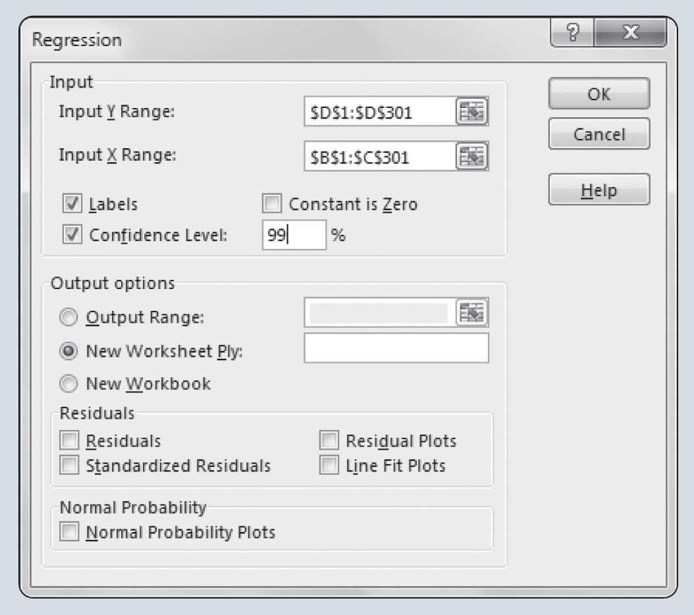
The Multiple Regression Model (Slide 9 of 11)
Figure 7.12: Regression Dialog Box
Notes:
Step 4. When the Regression dialog box appears (as shown in Figure 7.12):
1. Enter D1:D301 in the Input Y Range: box
2. Enter B1:C301 in the Input X Range: box
3. Select Labels
Selecting Labels tells Excel to use the names you have given to your variables in row 1 when displaying the regression model output.
4. Select Confidence Level:
5. Enter 99 in the Confidence Level: box
6. Select New Worksheet Ply:
7. Click OK

Slide 47
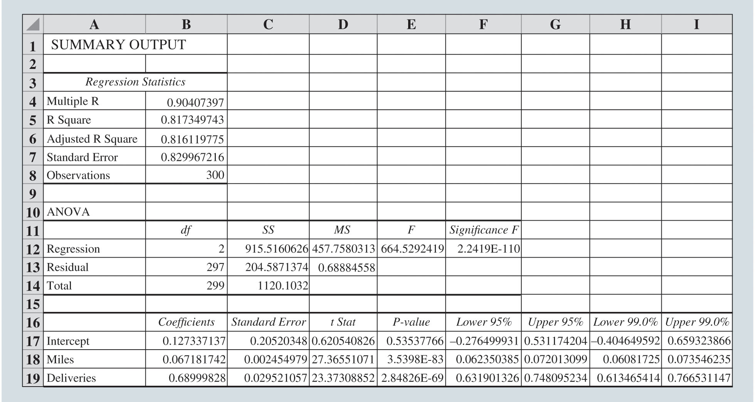
The Multiple Regression Model (Slide 10 of 11)
Figure 7.13: Excel Regression Output for the Butler Trucking Company with Miles and Deliveries as Independent Variables
Notes:
In the Excel output shown in Figure 7.13, the label for the independent variable x₁ is Miles (see cell A18), and the label for the independent variable x₂ is Deliveries (see cell A19).
Estimated regression equation:
$\hat{y}$ = 0.1273 + 0.0672x₁ + 0.6900x₂
Interpretation:
For a fixed number of deliveries, we estimate that the mean travel time will increase by 0.0672 hours when the distance traveled increases by 1 mile.
For a fixed distance traveled, we estimate that the mean travel time will increase by 0.69 hours when the number of deliveries increases by 1 delivery.
Multiple coefficient of determination, R² = 0.8173.
Interpretation: 81.73% of the variability in sample values of the dependent variable, travel time, is explained by the independent variables, number of deliveries and distance traveled.

Slide 48
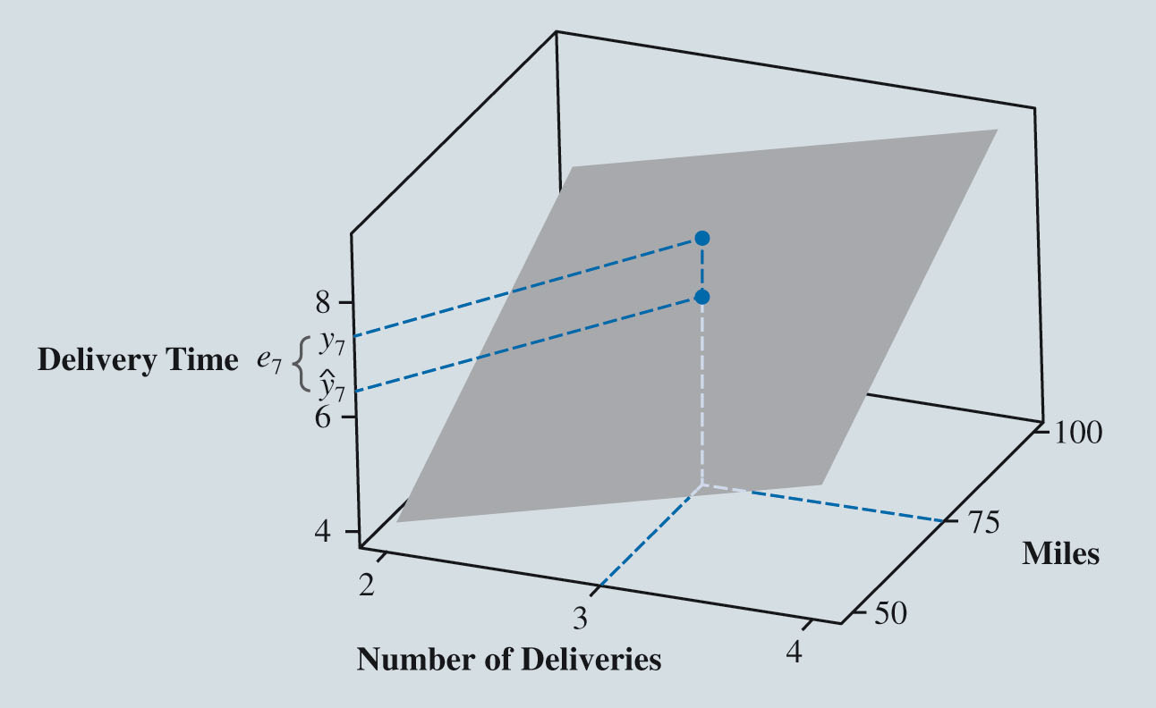
The Multiple Regression Model (Slide 11 of 11)
Figure 7.14: Graph of the Regression Equation for Multiple Regression Analysis with Two Independent Variables
Notes:
With two independent variables x₁ and x₂, we now generate a predicted value of y for every combination of values of x₁ and x₂.
Thus, instead of a regression line, we now create a regression plane in three-dimensional space.
Figure 7.14 provides the graph of the estimated regression plane for the Butler Trucking Company example and shows the seventh driving assignment in the data.
As the plane slopes upward to larger values of total travel time ($\hat{y}$) as either the number of miles traveled (x₁) or the number of deliveries (x₂) increases.
The residual for a driving assignment when x₁ = 75 and x₂ = 3 is the difference between the observed y value and the estimated mean value of y when
x₁ = 75 and x₂ = 3.
The observed value lies above the regression plane, indicating that the regression model underestimates the expected driving time for the seventh driving assignment.

Slide 49
Inference and Regression
Conditions Necessary for Valid Inference in the Least Squares Regression Model
Testing Individual Regression Parameters
Addressing Nonsignificant Independent Variables
Multicollinearity

Slide 50
Inference and Regression (Slide 1 of 15)
Statistical inference: Process of making estimates and drawing conclusions about one or more characteristics of a population (the value of one or more parameters) through the analysis of sample data drawn from the population.
In regression, inference is commonly used to estimate and draw conclusions about:
The regression parameters
The mean value and/or the predicted value of the dependent variable y for specific values of the independent variables
Consider both hypothesis testing and interval estimation.

Slide 51
Inference and Regression (Slide 2 of 15)
Conditions Necessary for Valid Inference in the Least Squares Regression Model:
For any given combination of values of the independent variables
the population of potential error terms
is normally distributed with a mean of 0 and a constant variance.
The values of
are statistically independent.

Slide 52
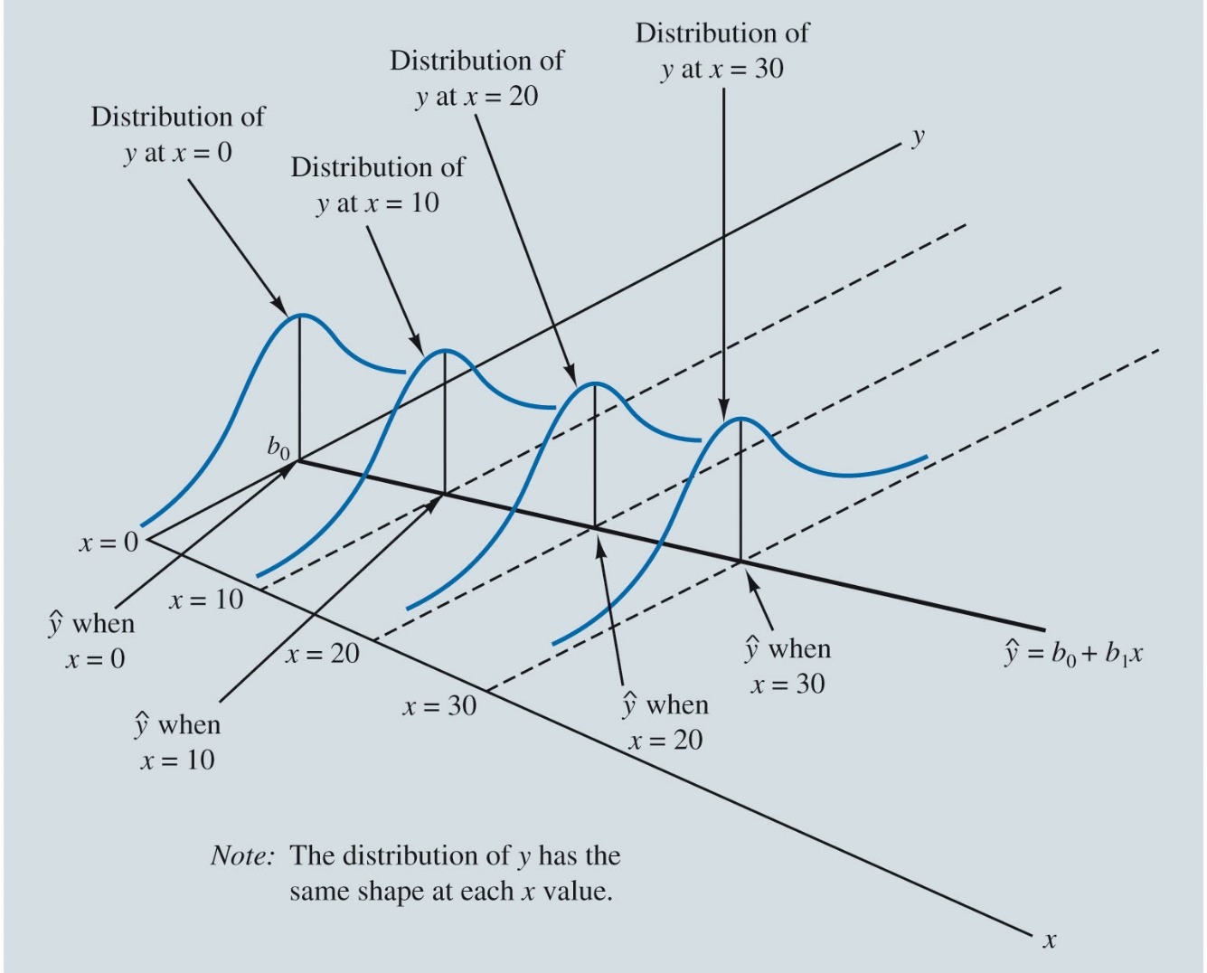
Inference and Regression (Slide 3 of 15)
Figure 7.15: Illustration of the Conditions for Valid Inference in Regression
Notes:
Figure 7.15 illustrates the model conditions and their implications for a simple linear regression.
Note that in this graphical interpretation, the value of E(y|x) changes linearly according to the specific value of x considered, and so the mean error is zero at each value of x.
However, regardless of the x value, the error term ε and hence the dependent variable y are normally distributed, each with the same variance.
The specific value of the error ε at any particular point depends on whether the actual value of y is greater or less than E(y|x).

Slide 53
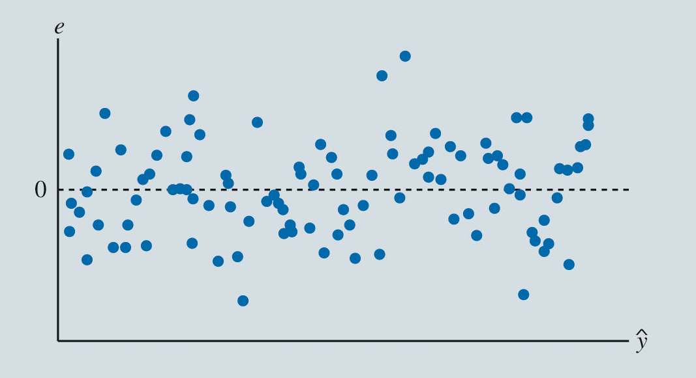
Inference and Regression (Slide 4 of 15)
Figure 7.16: Example of a Random Error Pattern in a Scatter Chart of Residuals and Predicted Values of the Dependent Variable
Notes:
Simple scatter charts of the residuals and independent variables are an extremely effective method for assessing whether these conditions are violated.
We should review the scatter chart for patterns in the residuals indicating that one or more of the conditions have been violated.
Ideally, the residuals will be consistently scattered around zero throughout the predicted values of the independent variable.
This is shown in the example in Figure 7.16.

Slide 54
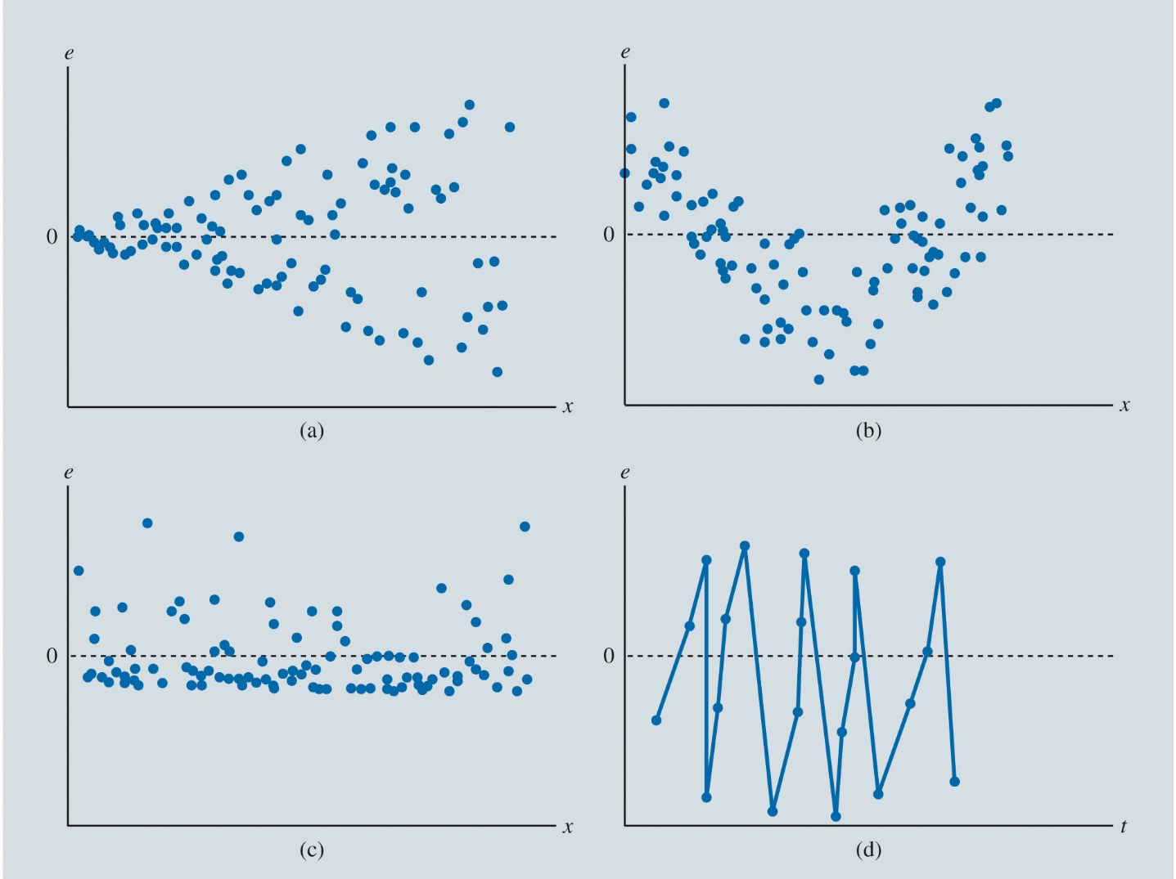
Inference and Regression (Slide 5 of 15)
Figure 7.17: Examples of Diagnostic Scatter Charts of Residuals from Four Regressions
Notes:
The residuals in the four panels of Figure 7.17 show distinct patterns, each of which suggests a violation of at least one of the regression model conditions.
In panel a, the variation in the residuals e increases as the value of the independent variable x increases, suggesting that the residuals do not have a constant variance.
In panel b, the residuals are positive for small and large values of the independent variable x but are negative for moderate values of the independent variable.
This pattern suggests that the linear relationships in the regression model underpredicts the value of dependent variable for small and large values of the independent variable and overpredicts the value of the dependent variable for intermediate values of the independent variable.
The residuals in panel c are not symmetrically distributed around 0; many of the negative residuals are relatively close to zero, while the relatively few positive residuals tend to be far from zero. This skewness suggests that the residuals are not normally distributed.
The residuals in panel d are plotted over time t, which generally serves as an independent variable; that is, an observation is made at each of several (usually equally spaced) points in time.

Slide 55
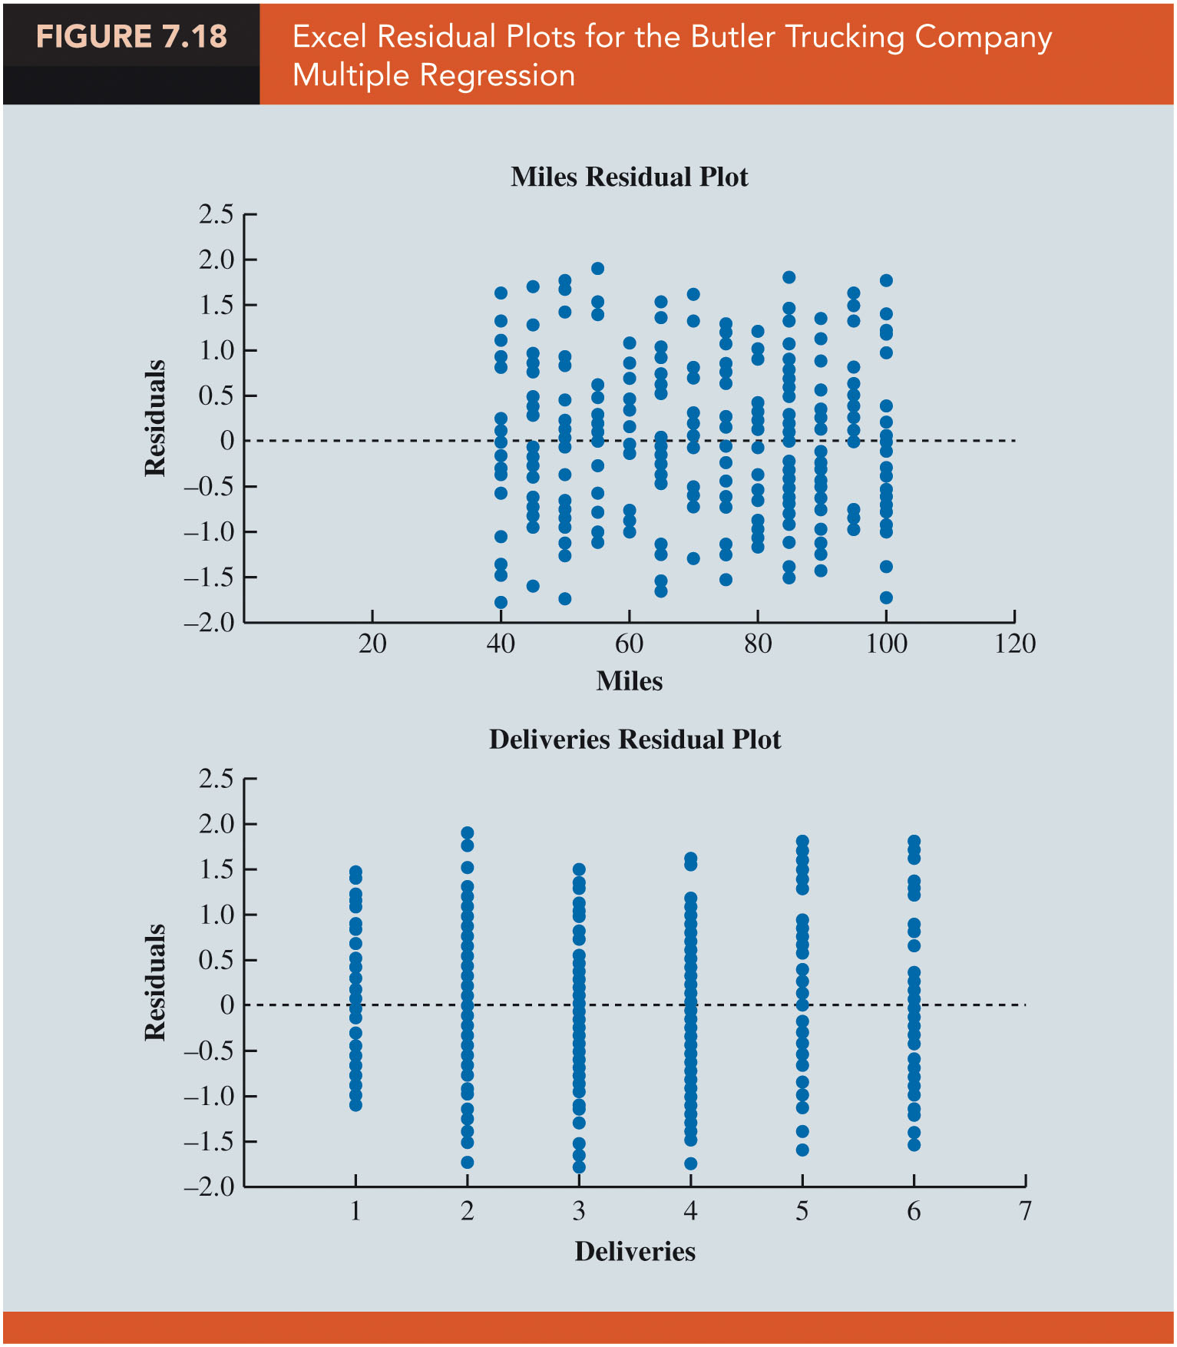
Inference and Regression (Slide 6 of 15)
Figure 7.18: Excel Residual Plots for the Butler Trucking Company Multiple Regression
Notes:
You can generate scatter charts of the residuals against each independent variable in the model when using Excel’s Regression tool; to do so, select the Residual Plots option in the Residuals area of the Regression dialog box.
Figure 7.18 shows residual plots produced by Excel for the Butler Trucking Company example for which the independent variables are miles (x₁) and deliveries (x₂).
The residuals at each value of miles appear to have a mean of zero, to have similar variances, and to be concentrated around zero.
The residuals at each value of deliveries also appear to have a mean of zero, to have similar variances, and to be concentrated around zero.

Slide 56
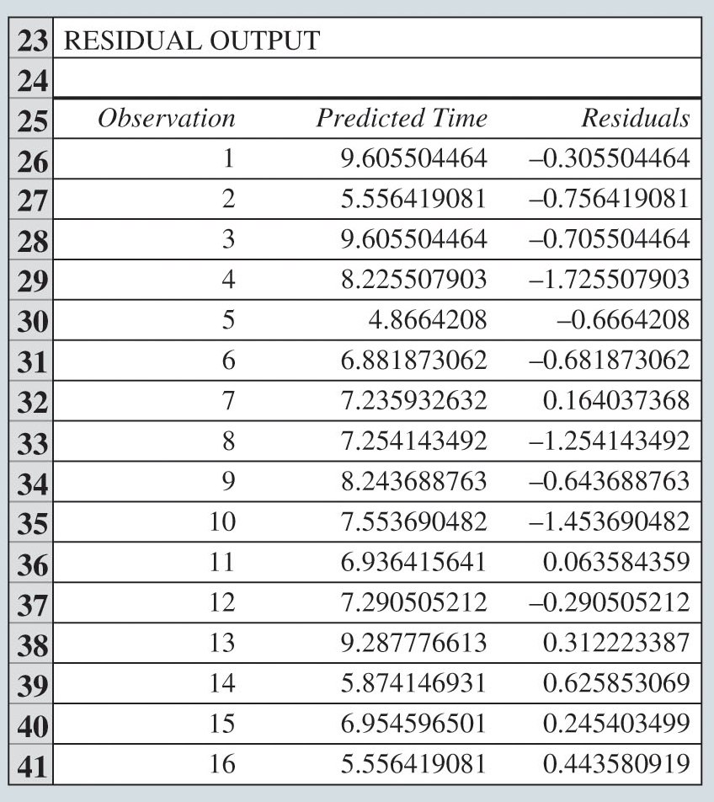
Inference and Regression (Slide 7 of 15)
Figure 7.19: Table of the First Several Predicted Values
and Residuals e Generated by the Excel Regression Tool

Slide 57
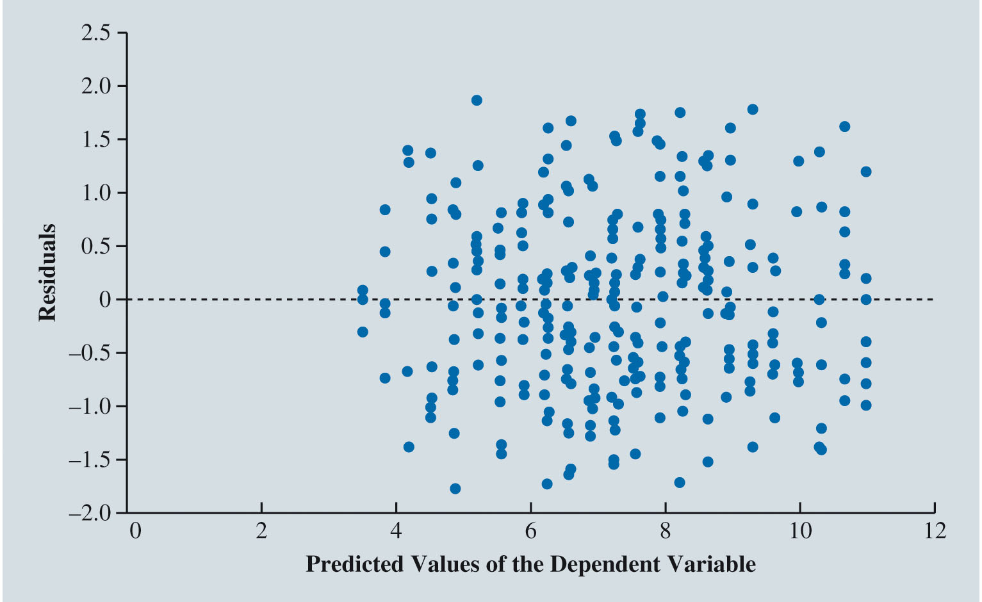
Inference and Regression (Slide 8 of 15)
Figure 7.20: Scatter Chart of Predicted Values
and Residuals e

Slide 58
Inference and Regression (Slide 9 of 15)
Testing Individual Regression Parameters:
To determine whether statistically significant relationships exist between the dependent variable y and each of the independent variables
individually.
If a
there is no linear relationship between the dependent variable y
and the independent variable
If a
there is a linear relationship between y and

Slide 59
Inference and Regression (Slide 10 of 15)
Testing Individual Regression Parameters (cont.):
Use a t test to test the hypothesis that a regression parameter
is zero.
The test statistic for this t test,
Estimated standard deviation of
As the magnitude of t increases (as t deviates from zero in either direction), we are more likely to reject the hypothesis that the regression parameter
is zero.
Notes:
When we reject the hypothesis that the regression parameter β_{j} is zero, we conclude that a relationship exists between the dependent variable y and the independent variable x_{j}.
Statistical software will generally report a p value for this test statistic.
For a given value of t, this p value represents the probability of collecting a sample of the same size from the same population that yields a larger t statistic given that the value of β_{j} is actually zero.
The hypothesis β_{j} is equal to zero is rejected when the corresponding p value is smaller than some predetermined level of significance (usually 0.05 or 0.01).

Slide 60
Inference and Regression (Slide 11 of 15)
Testing Individual Regression Parameters (cont.):
Confidence interval can be used to test whether each of the regression parameters
is equal to zero.
Confidence interval: An estimate of a population parameter that provides an interval believed to contain the value of the parameter at some level of confidence.
Confidence level: Indicates how frequently interval estimates based on samples of the same size taken from the same population using identical sampling techniques will contain the true value of the parameter we are estimating.
Notes:
To test that β_{j} is zero (i.e., there is no linear relationship between x_{j} and y) at some predetermined level of significance (say 0.05), first build a confidence interval at the (1 – 0.05)100% confidence level.
If the resulting confidence interval does not contain zero, we conclude that β_{j} differs from zero at the predetermined level of significance.
Similarly, to test that β₀ is zero (i.e., the value of the dependent variable is zero when all the independent variables x₁, x₂, . . . , x_{q} are equal to zero) at some predetermined level of significance (say 0.05), first build a confidence interval at the (1 – 0.05)100% confidence level.
If the resulting confidence interval does not contain zero, we conclude that β₀ differs from zero at the predetermined level of significance.

Slide 61
Inference and Regression (Slide 12 of 15)
Addressing Nonsignificant Independent Variables:
If practical experience dictates that the nonsignificant independent variable has a relationship with the dependent variable, the independent variable should be left in the model.
If the model sufficiently explains the dependent variable without the nonsignificant independent variable, then consider rerunning the regression without the nonsignificant independent variable.
The appropriate treatment of the inclusion or exclusion of the y-intercept when
is not statistically significant may require special consideration.
Notes:
Note that it is possible that the estimates of the other regression coefficients and their p values may change considerably when we remove the nonsignificant independent variable from the model.
Since the primary purpose of the regression model is to explain or predict values of the dependent variable for values of the independent variables that lie within the experimental region on which the model is based, regression through the origin should not be forced unless there are strong a priori reasons for believing that the dependent variable is equal to zero when the values of all independent variables in the model are equal to zero.

Slide 62
Inference and Regression (Slide 13 of 15)
Multicollinearity:
Multicollinearity refers to the correlation among the independent variables in multiple regression analysis.
In t tests for the significance of individual parameters, the difficulty caused by multicollinearity is that it is possible to conclude that a parameter associated with one of the multicollinear independent variables is not significantly different from zero when the independent variable actually has a strong relationship with the dependent variable.
This problem is avoided when there is little correlation among the independent variables.
Notes:
According to a common rule of thumb test, multicollinearity is a potential problem if the absolute value of the sample correlation coefficient exceeds 0.7 for any two of the independent variables.
The primary consequence of multicollinearity is that it increases the variances and standard errors of the regression estimates of β₀, β₁, β₂, . . . , β_{q} and predicted values of the dependent variable, and so inference based on these estimates is less precise than it should be.

Slide 63
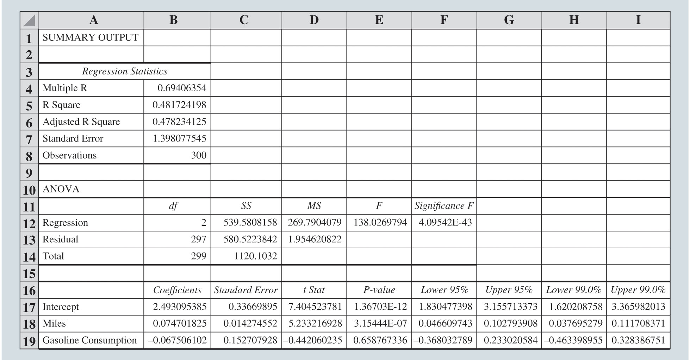
Inference and Regression (Slide 14 of 15)
Figure 7.21: Excel Regression Output for the Butler Trucking Company with Miles and Gasoline Consumption as Independent Variables
Notes:
Using Excel’s Regression tool, we obtain the results shown in Figure 7.21 for our multiple regression.
When we conduct a t test to determine whether β₁ is equal to zero, we find a p value of 3.1544E-07, and so we reject this hypothesis and conclude that travel time is related to miles traveled.
On the other hand, when we conduct a t test to determine whether β₂ is equal to zero, we find a p value of 0.6588, and so we do not reject this hypothesis.

Slide 64
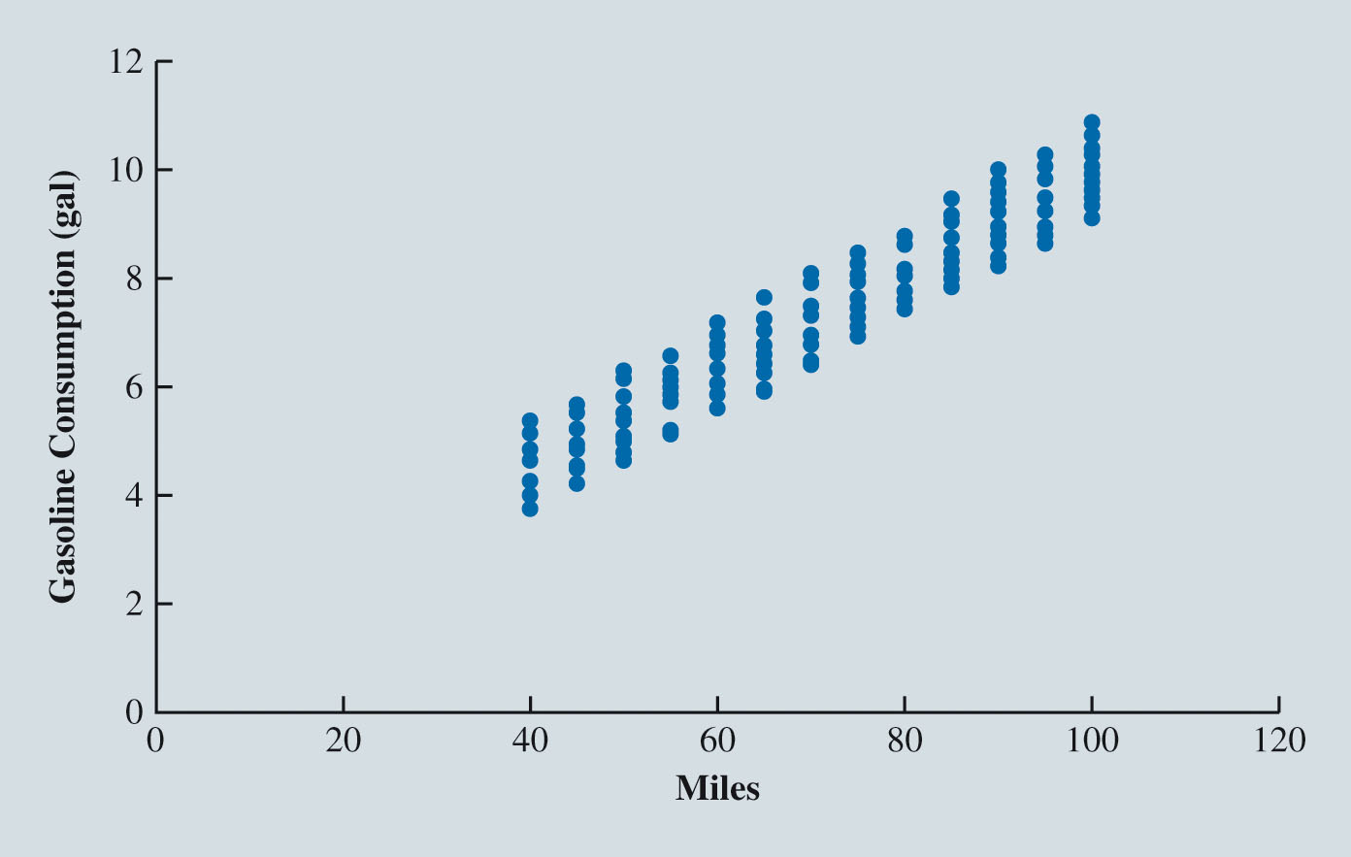
Inference and Regression (Slide 15 of 15)
Figure 7.22: Scatter Chart of Miles and Gasoline Consumed for Butler Trucking Company
Notes:
Using the regression output shown in Figure 7.21, we can use the Excel chart tool to create a scatter chart of these predicted values and residuals, similar to the chart in Figure 7.22.
The figure shows that miles traveled and gasoline consumed are strongly related.

Slide 65
Big Data and Regression (Slide 1 of 2)
Multicollinearity (cont.):
Testing for an overall regression relationship:
Use an F test based on the F probability distribution.
If the F test leads us to reject the hypothesis that the values of
are all zero:
Conclude that there is an overall regression relationship.
Otherwise, conclude that there is no overall regression relationship.

Slide 66
Big Data and Regression (Slide 2 of 2)
Multicollinearity (cont.):
Testing for an overall regression relationship (cont.):
The test statistic generated by the sample data for this test is:
SSR = Sum of squares due to regression.
SSE = Sum of squares due to error.
q = the number of independent variables in the regression model.
n = the number of observations in the sample.
Larger values of F provide stronger evidence of an overall regression relationship.
Notes:
The numerator of this test statistic is a measure of the variability in the dependent variable y that is explained by the independent variables x₁, x₂, . . . , x_{q}.
The denominator is a measure of the variability in the dependent variable y that is not explained by the independent variables x₁, x₂, . . . , x_{q.}
Statistical software will generally report a p value for this test statistic.
For a given value of F, the p-value represents the probability of collecting a sample of the same size from the same population that yields a larger F statistic given that the values of b₁, b₂, . . . , b_{q} are all actually zero.
Thus, smaller p values indicate stronger evidence against the hypothesis that the values of b₁, b₂, . . . , b_{q} are all zero (i.e., stronger evidence of an overall regression relationship).
The hypothesis is rejected when the p value is smaller than some predetermined value (usually 0.05 or 0.01) that is referred to as the level of significance.

Slide 67
Categorical Independent Variables
Butler Trucking Company and Rush Hour
Interpreting the Parameters
More Complex Categorical Variables

Slide 68
Categorical Independent Variables (Slide 1 of 10)
Butler Trucking Company and Rush Hour:
Dependent variable, y: Travel time.
Independent variables: miles traveled
and number of deliveries
0 if an assignment did not include travel on the congested segment of highway during afternoon rush hour.
Categorical variable: rush hour
1 if an assignment included travel on the congested segment of highway during afternoon rush hour.
Categorical variable: rush hour
Notes:
The previous independent variables we have considered (such as miles traveled and number of deliveries) have been quantitative, but the new variable, rush hour, is categorical. This variable is also called a dummy variable.
Will this dummy variable add valuable information to the current Butler Trucking regression model?
A review of the residuals produced by the current model may help us make an initial assessment.
We can create a frequency distribution and a histogram of the residuals for driving assignments that included travel on a congested segment of a highway during the afternoon rush hour period.
We then create a frequency distribution and a histogram of the residuals for driving assignments that did not include travel on a congested segment of a highway during the afternoon rush hour period.

Slide 69
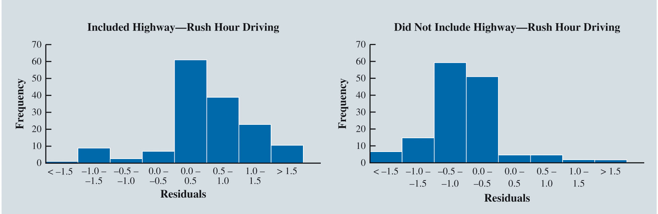
Categorical Independent Variables (Slide 2 of 10)
Figure 7.23: Histograms of the Residuals for Driving Assignments That Included Travel on a Congested Segment of a Highway During the Afternoon Rush Hour and Residuals for Driving Assignments That Did Not
Notes:
We know that the residual for the ith observation is e_{i} = y_{i} - ${\hat{y}}_{i}$, which is the difference between the observed and predicted values of the dependent variable.
The histograms in Figure 7.23 show that driving assignments that included travel on a congested segment of a highway during the afternoon rush hour period tend to have positive residuals, which means we are generally underpredicting the travel times for those driving assignments.
Conversely, driving assignments that did not include travel on a congested segment of a highway during the afternoon rush hour period tend to have negative residuals, which means we are generally overpredicting the travel times for those driving assignments.
These results suggest that the dummy variable could potentially explain a substantial proportion of the variance in travel time that is unexplained by the current model, and so we proceed by adding the dummy variable x₃ to the current Butler Trucking multiple regression model.

Slide 70
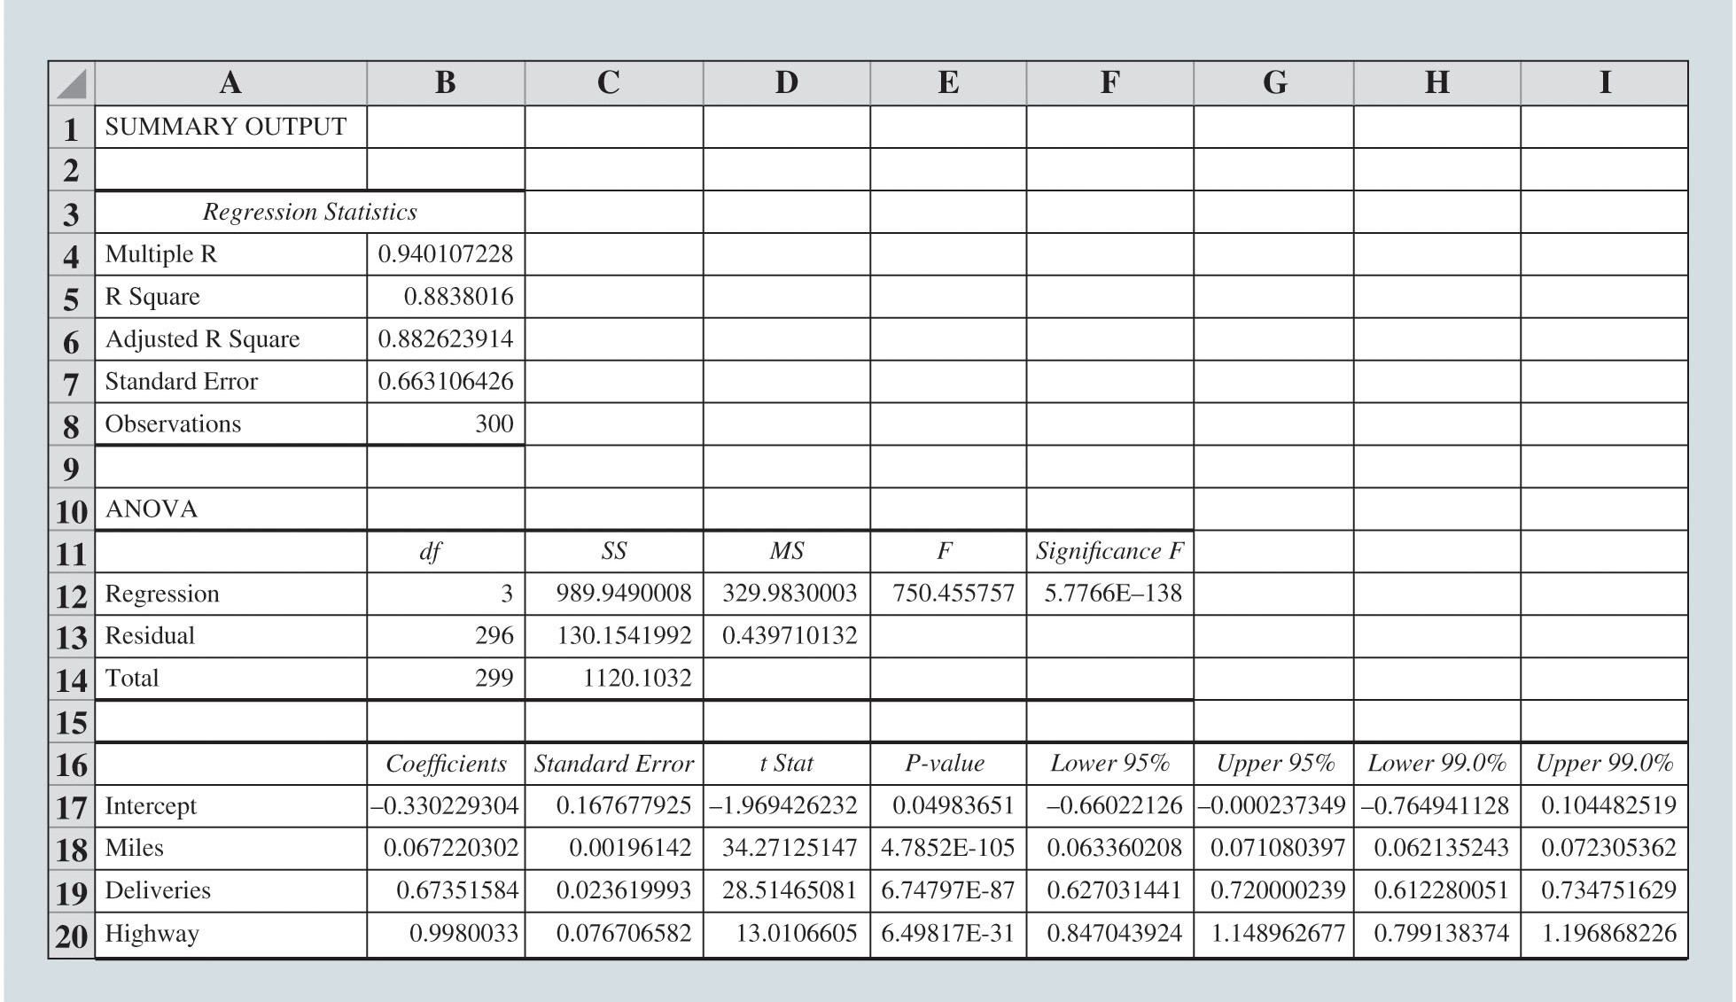
Categorical Independent Variables (Slide 3 of 10)
Figure 7.24: Excel Data and Output for Butler Trucking with Miles Traveled
Number of Deliveries
and the Highway Rush Hour Dummy Variable
as the Independent Variables
Notes:
Using Excel’s Regression tool to develop the estimated regression equation, we obtained the Excel output in Figure 7.24.
The estimated regression equation is $\hat{y}$ = –0.3302 + 0.0672x₁ + 0.6735x₂ + 0.9980x₃.

Slide 71
Categorical Independent Variables (Slide 4 of 10)
Interpreting the Parameters:
The model estimates that travel time increases by:
0.0672 hours for every increase of 1 mile traveled, holding constant the number of deliveries and whether the driving assignment route requires the driver to travel on the congested segment of a highway during the afternoon rush hour period.
0.6735 hours for every delivery, holding constant the number of miles traveled and whether the driving assignment route requires the driver to travel on the congested segment of a highway during the afternoon rush hour period.

Slide 72
Categorical Independent Variables (Slide 5 of 10)
Interpreting the Parameters (cont.):
The model estimates that travel time increases by (cont.):
0.9980 hours if the driving assignment route requires the driver to travel on the congested segment of a highway during the afternoon rush hour period, holding constant the number of miles traveled and the number of deliveries.
indicates that the regression model explains approximately 88.4% of the variability in travel time for the driving assignments in the sample.

Slide 73
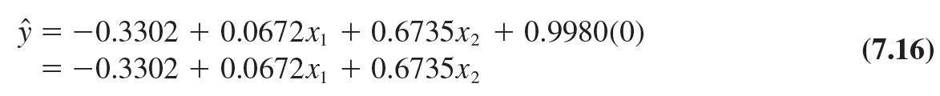
Categorical Independent Variables (Slide 6 of 10)
Interpreting the Parameters (cont.):
Compare the regression model for the case when
and when
When
When

Slide 74
Categorical Independent Variables (Slide 7 of 10)
More Complex Categorical Variables:
If a categorical variable has k levels,
dummy variables are required, with each dummy variable corresponding to one of the levels of the categorical variable and coded as 0 or 1.
Example:
Suppose a manufacturer of vending machines organized the sales territories for a particular state into three regions: A, B, and C.
The managers want to use regression analysis to help predict the number of vending machines sold per week.
Suppose the managers believe sales region is one of the important factors in predicting the number of units sold.
Notes:
Dummy variables are often used to model seasonal effects in sales data.

Slide 75

Categorical Independent Variables (Slide 8 of 10)
More Complex Categorical Variables (cont.):
Example (cont.):
Sales region: categorical variable with three levels (A, B, and C).
Number of dummy variables =
Each variable can be coded 0 or 1 as:
The values of

Slide 76
Categorical Independent Variables (Slide 9 of 10)
More Complex Categorical Variables (cont.):
Example (cont.):
The regression equation relating the mean number of units sold to the dummy variables is written as:
Observations corresponding to Region A correspond to
so the estimated mean number of units sold in Region A is:
Notes:
b₀ = Mean or expected value of sales for Region A.
b₁ = Difference between the mean number of units sold in Region B and the mean number of units sold in Region A.
b₂ = Difference between the mean number of units sold in Region C and the mean number of units sold in Region A.

Slide 77
Categorical Independent Variables (Slide 10 of 10)
More Complex Categorical Variables (cont.):
Example (cont.):
Observations corresponding to Region B are coded
so the estimated mean number of units sold in Region B is:
Observations corresponding to Region C are coded
so the estimated mean number of units sold in Region C is:
Notes:
Two dummy variables were required in this example because sales region is a categorical variable with three levels. But the assignment of specific variables is arbitrary.
The important point to remember is that when a categorical variable has k levels, k – 1 dummy variables are required in the multiple regression analysis.

Slide 78
Modeling Nonlinear Relationships
Quadratic Regression Models
Piecewise Linear Regression Models
Interaction Between Independent Variables

Slide 79
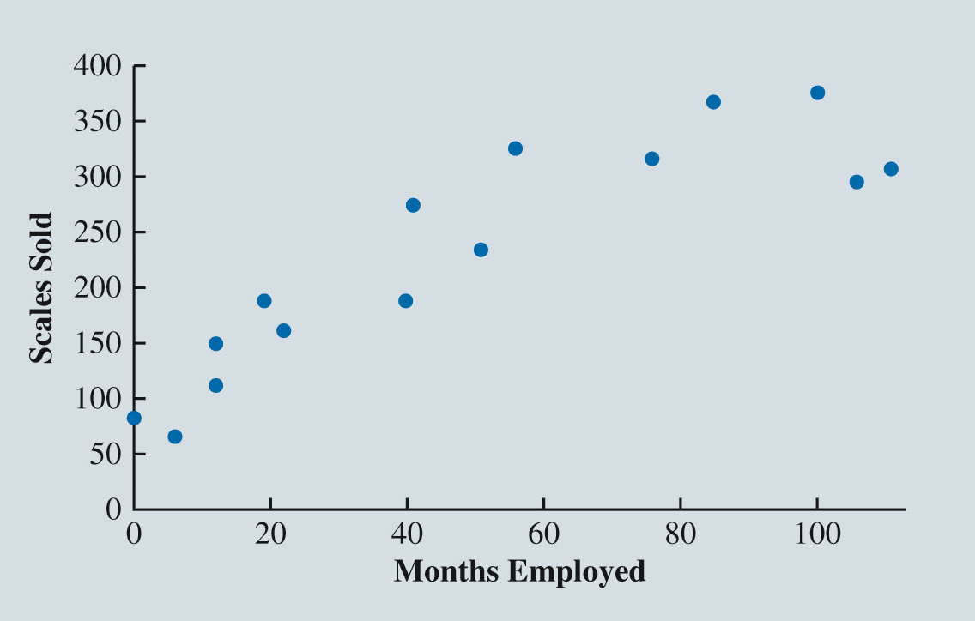
Modeling Nonlinear Relationships (Slide 1 of 16)
Figure 7.25: Scatter Chart for the Reynolds Example
Notes:
Reynolds, Inc., is a manufacturer of industrial scales and laboratory equipment.
Managers at Reynolds want to investigate the relationship between length of employment of their salespeople and the number of electronic laboratory scales sold.
Figure 7.25, the scatter chart for these data, indicates a possible curvilinear relationship between the length of time employed and the number of units sold.

Slide 80
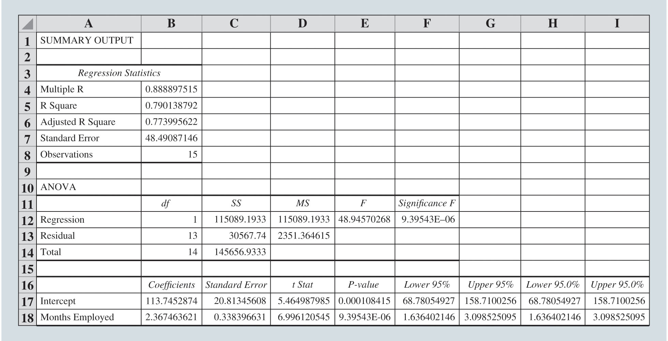
Modeling Nonlinear Relationships (Slide 2 of 16)
Figure 7.26: Excel Regression Output for the Reynolds Example
Notes:
Figure 7.26 is the Excel output for a simple linear regression.
The estimated regression: Sales = 113.7453 + 2.3675 Months Employed.
The computer output shows that the relationship is significant (p value = 9.3954E-06 in cell E18 of Figure 7.26 for the t test that β₁ = 0) and that a linear relationship explains a high percentage of the variability in sales (r ² = 0.7901 in cell B5).

Slide 81
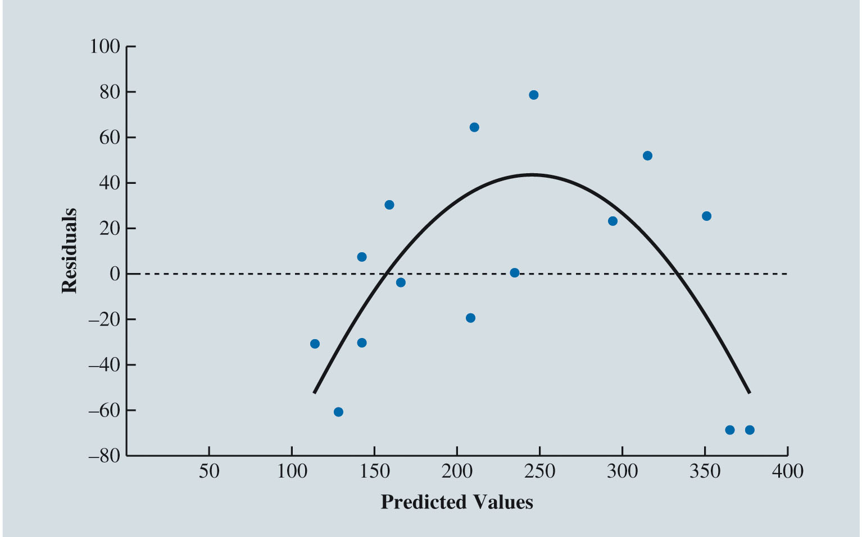
Modeling Nonlinear Relationships (Slide 3 of 16)
Figure 7.27: Scatter Chart of the Residuals and Predicted Values of the Dependent Variable for the Reynolds Simple Linear Regression
Notes:
The pattern in the scatter chart of residuals against the predicted values of the dependent variable in Figure 7.27 suggests that a curvilinear relationship may provide a better fit to the data.
If we have a practical reason to suspect a curvilinear relationship between the number of electronic laboratory scales sold by a salesperson and the number of months the salesperson has been employed, we may wish to consider an alternative to simple linear regression.
For example, we may believe that a recently hired salesperson faces a learning curve but becomes increasingly more effective over time and that a salesperson who has been in a sales position with Reynolds for a long time eventually becomes burned out and becomes increasingly less effective.
If our regression model supports this theory, Reynolds management can use the model to identify the approximate point in employment when its salespeople begin to lose their effectiveness, and management can plan strategies to counteract salesperson burnout.

Slide 82
Modeling Nonlinear Relationships (Slide 4 of 16)
Quadratic Regression Models:
In the Reynolds example, to account for the curvilinear relationship between months employed and scales sold, we could include the square of the number of months the salesperson has been employed as a second independent variable.
An estimated regression equation given by:
Equation (7.18) corresponds to a quadratic regression model.

Slide 83
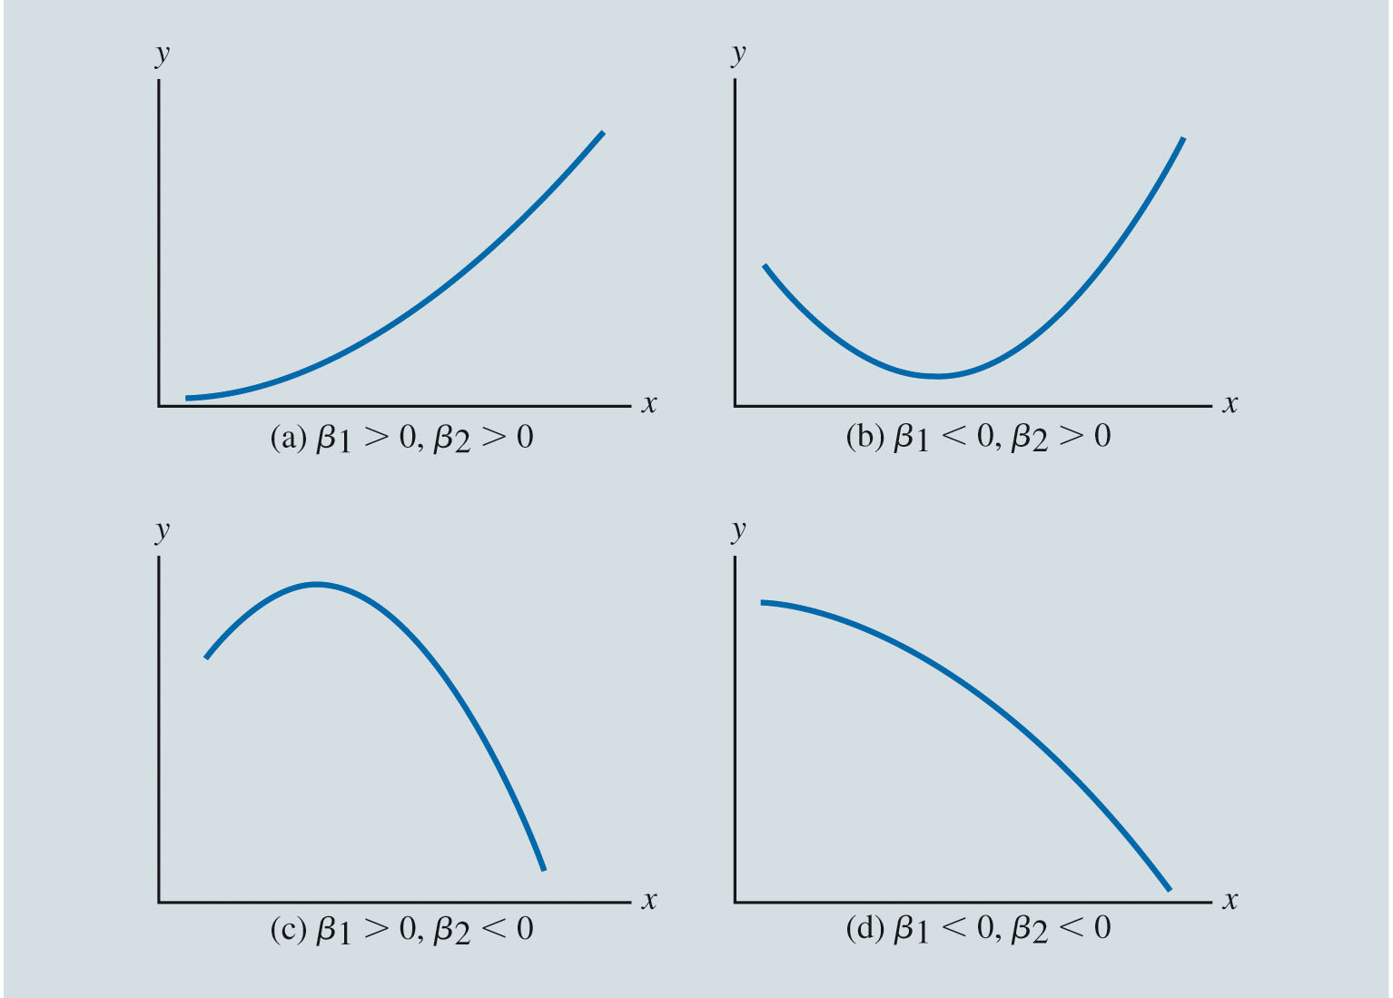
Modeling Nonlinear Relationships (Slide 5 of 16)
Figure 7.28: Relationships That Can Be Fit with a Quadratic Regression Model

Slide 84
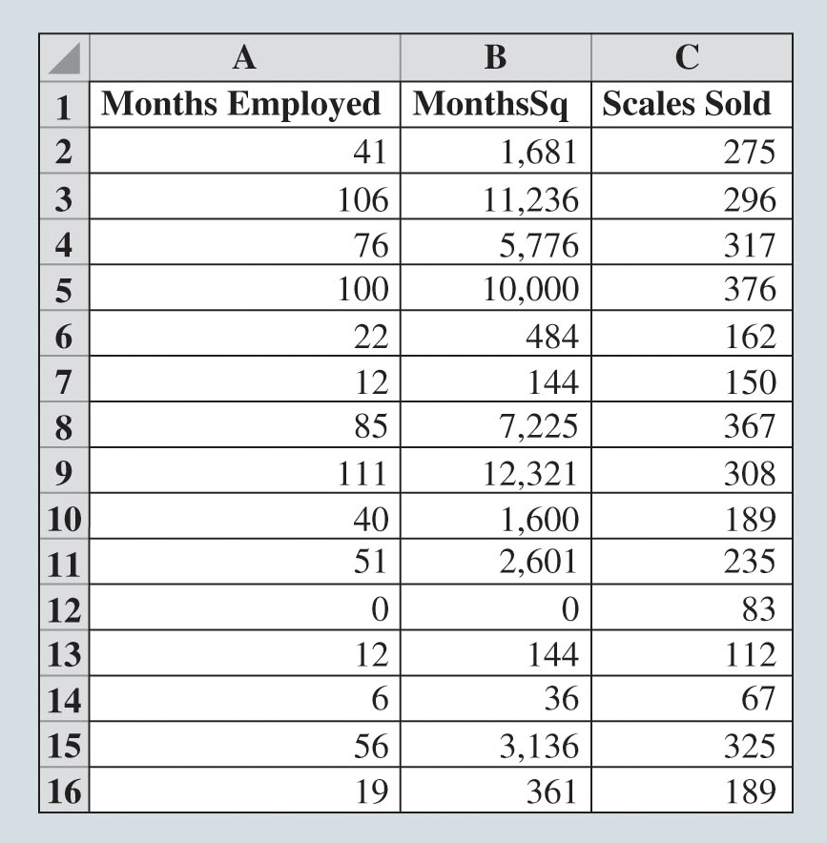
Modeling Nonlinear Relationships (Slide 6 of 16)
Figure 7.29: Excel Data for the Reynolds Quadratic Regression Model
Notes:
Figure 7.29 shows the Excel spreadsheet that includes the square of the number of months the employee has been with the firm.
To create the variable, which we will call MonthsSq, we create a new column and set each cell in that column equal to the square of the associated value of the variable Months. These values are shown in Column B of Figure 7.29.

Slide 85
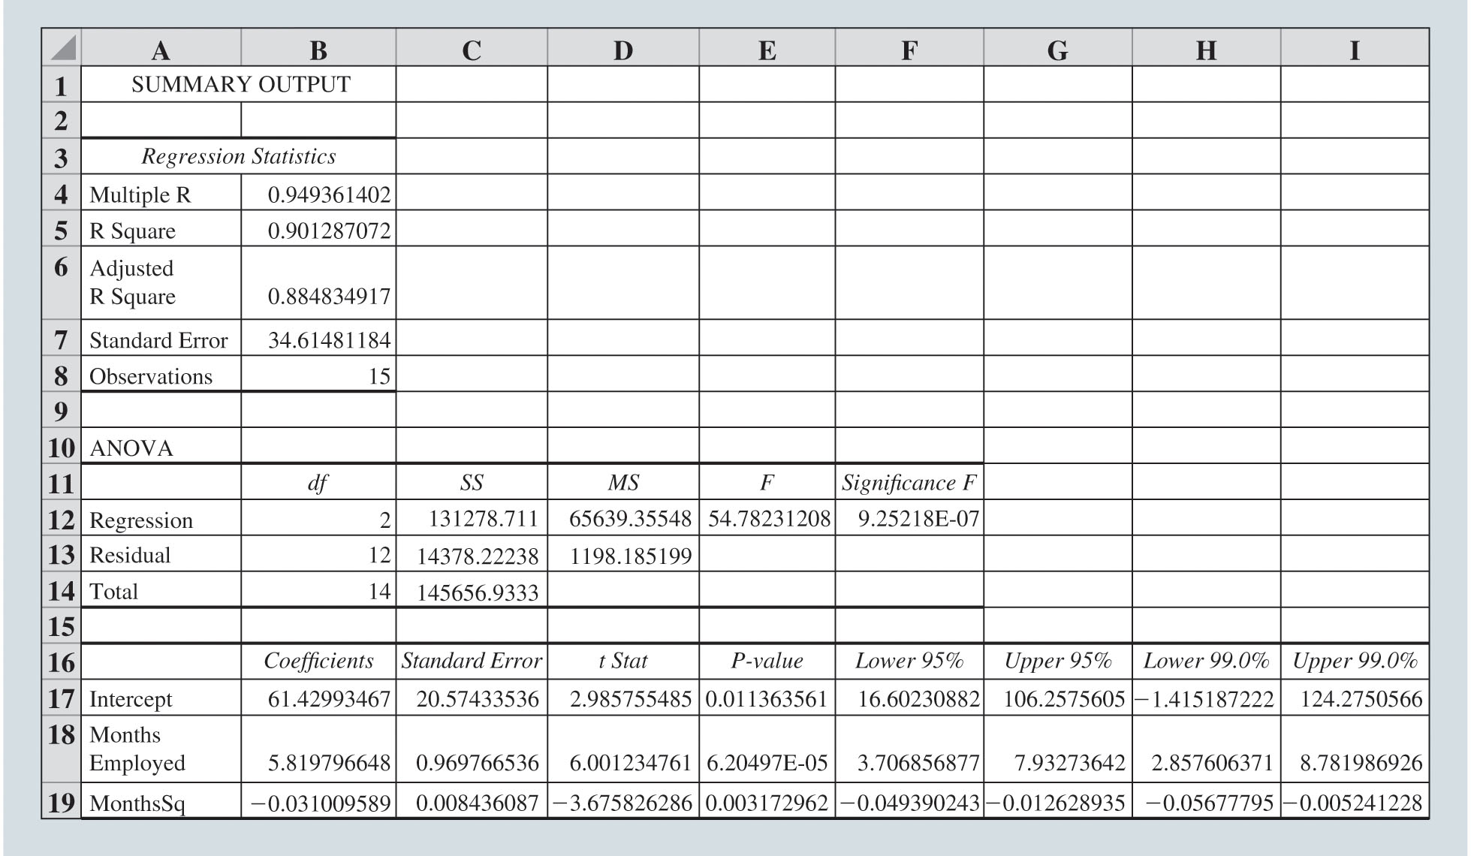
Modeling Nonlinear Relationships (Slide 7 of 16)
Figure 7.30: Excel Output for the Reynolds Quadratic Regression Model
Notes:
The estimated regression equation is Sales = 61.4299 + 5.8198 Months Employed – 0.0310 MonthsSq
MonthsSq is the square of the number of months the salesperson has been employed.
Because the value of b₁ (5.8198) is positive, and the value of b₂ (–0.0310) is negative, $\hat{y}$ will initially increase as the number of months the salesperson has been employed increases.
As the value of the independent variable Months Employed increases, its squared value increases more rapidly, and eventually $\hat{y}$ will decrease as the number of months the salesperson has been employed increases.
The R² of 0.9013 indicates that this regression model explains approximately 90.1% of the variation in Scales Sold for our sample data.

Slide 86
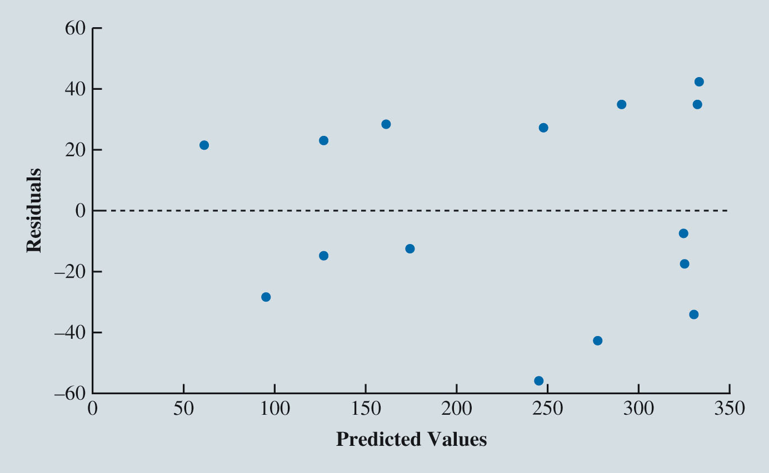
Modeling Nonlinear Relationships (Slide 8 of 16)
Figure 7.31: Scatter Chart of the Residuals and Predicted Values of the Dependent Variable for the Reynolds Quadratic Regression Model
Notes:
The lack of a distinct pattern in the scatter chart of residuals against the predicted values of the dependent variable (Figure 7.31) suggests that the quadratic model fits the data better than the simple linear regression in the Reynolds example (the scatter chart of residuals against the independent variable Months Employed would also lead us to this conclusion).

Slide 87
Modeling Nonlinear Relationships (Slide 9 of 16)
Piecewise Linear Regression Models:
For the Reynolds data, as an alternative to a quadratic regression model:
Recognize that below some value of Months Employed, the relationship between Months Employed and Sales appears to be positive and linear.
Whereas the relationship between Months Employed and Sales appears to be negative and linear for the remaining observations.
Piecewise linear regression model: This model will allow us to fit these relationships as two linear regressions that are joined at the value of Months at which the relationship between Months Employed and Sales changes.

Slide 88
Modeling Nonlinear Relationships (Slide 10 of 16)
Piecewise Linear Regression Models (cont.):
Knot: The value of the independent variable at which the relationship between dependent variable and independent variable changes; also called breakpoint.
For the Reynolds data, knot is the value of the independent variable Months Employed at which the relationship between Months Employed and Sales changes.

Slide 89
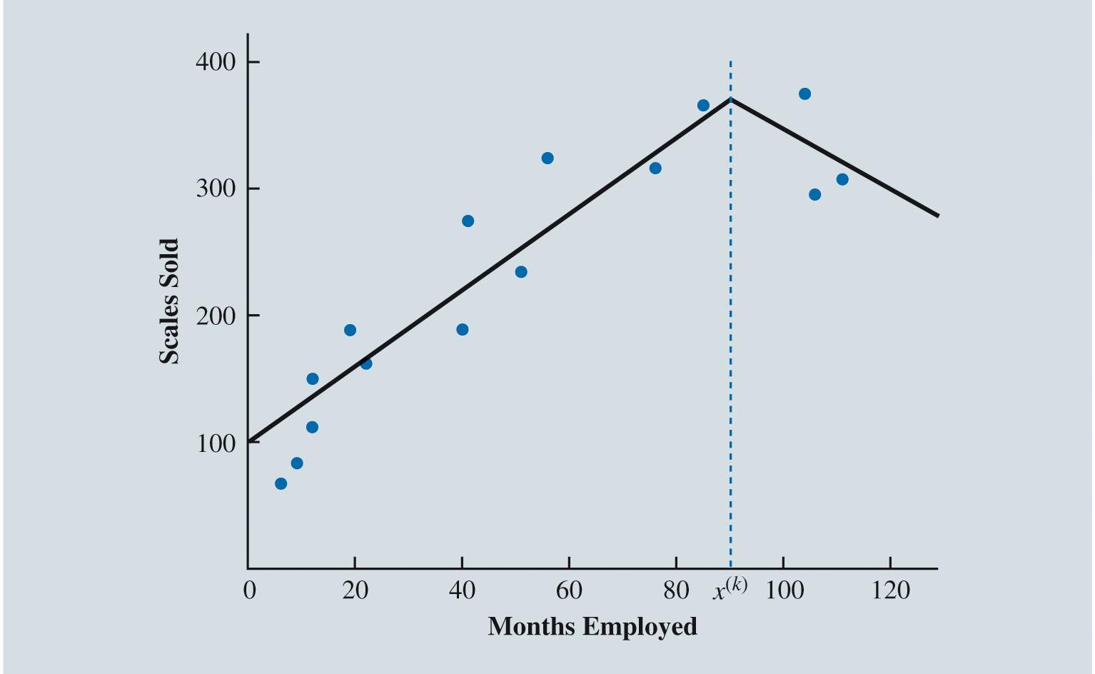
Modeling Nonlinear Relationships (Slide 11 of 16)
Figure 7.32: Possible Position of Knot
Notes:
Figure 7.32 provides the scatter chart for the Reynolds data with an indication of the possible location of the knot, which we have denoted x ^{(k)}.
From this scatter chart, it appears the knot is at approximately 90 months.

Slide 90
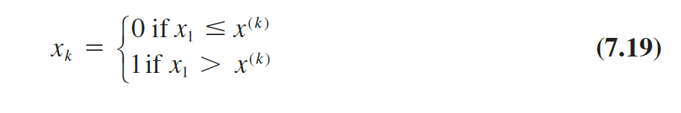
Modeling Nonlinear Relationships (Slide 12 of 16)
Piecewise Linear Regression Models (cont.):
Define a dummy variable:
Then fit the following estimated regression equation:
Notes:
Once we have decided on the location of the knot, we define a dummy variable that is equal to zero for any observation for which the value of Months Employed is less than or equal to the value of the knot, and equal to one for any observation for which the value of Months Employed is greater than the value of the knot.
The interpretation of this model is similar to the interpretation of the quadratic regression model.

Slide 91
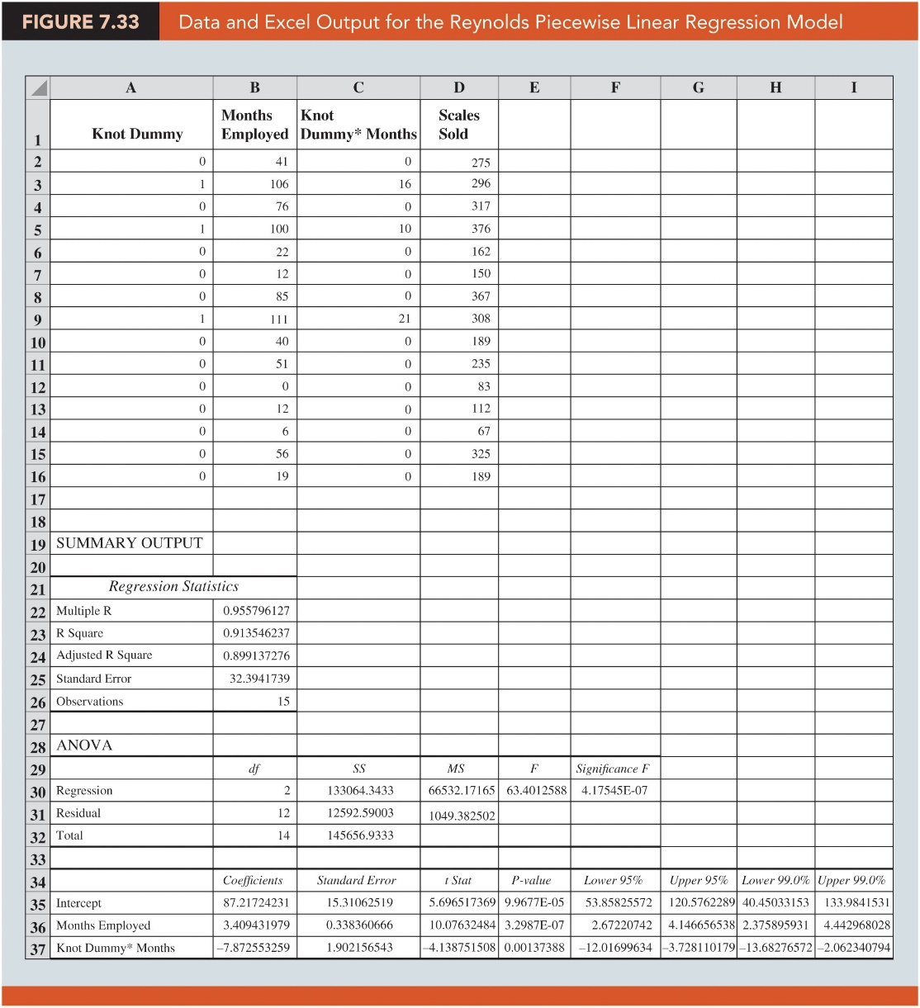
Modeling Nonlinear Relationships (Slide 13 of 16)
Figure 7.33: Data and Excel Output for the Reynolds Piecewise Linear Regression Model

Slide 92
Modeling Nonlinear Relationships (Slide 14 of 16)
Interaction Between Independent Variables:
Interaction: This occurs when the relationship between the dependent variable and one independent variable is different at various values of a second independent variable.
The estimated multiple linear regression equation is given as:
Notes:
In the multiple linear regression model, y is the dependent variable, x₁ and x₂ are independent variables.
x₁x₂ depicts interaction between the two independent variables.
When interaction between two variables is present, we cannot study the relationship between one independent variable and the dependent variable y independently of the other variable.
Once we obtain the estimated regression equation, using the p value approach, we can conclude whether the interaction is significant.
The interpretation of other coefficients is the same as the ones discussed in multiple linear regression.
Note that we can combine a quadratic effect with interaction to produce a second-order polynomial model with interaction between the two independent variables.

Slide 93
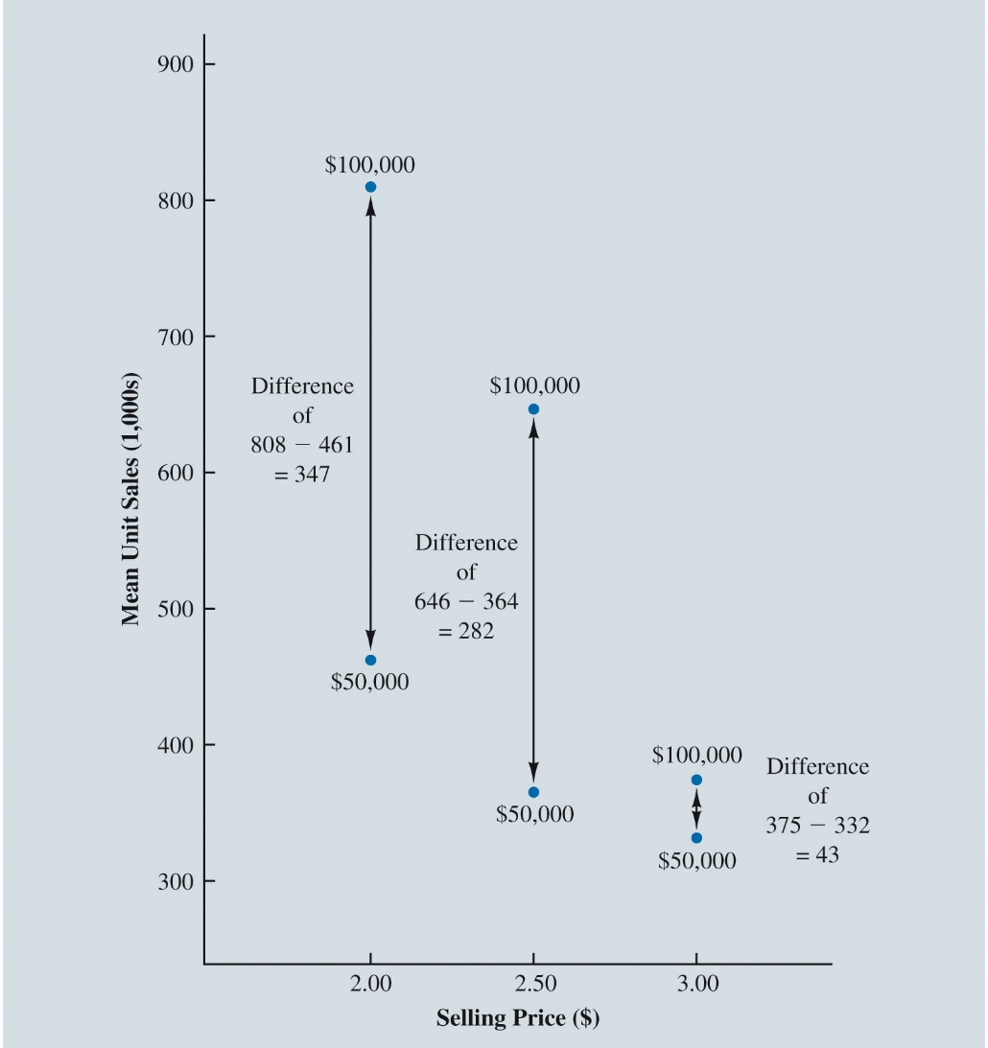
Modeling Nonlinear Relationships (Slide 15 of 16)
Figure 7.34: Mean Unit Sales (1,000s) as a Function of Selling Price and Advertising Expenditures
Notes:
Figure 7.34 shows the sample mean sales for the six price and advertising expenditure combinations.
Note that the sample mean sales corresponding to a price of $2.00 and an advertising expenditure of $50,000 is 461,000 units and that the sample mean sales corresponding to a price of $2.00 and an advertising expenditure of $100,000 is 808,000 units.
Hence, with price held constant at $2.00, the difference in mean sales between advertising expenditures of $50,000 and $100,000 is 808,000 – 461,000 = 347,000 units.
When the price of the product is $2.50, the difference in mean sales between advertising expenditures of $50,000 and $100,000 is 646,000 – 364,000 = 282,000 units.
Finally, when the price is $3.00, the difference in mean sales between advertising expenditures of $50,000 and $100,000 is 375,000 – 332,000 = 43,000 units.

Slide 94
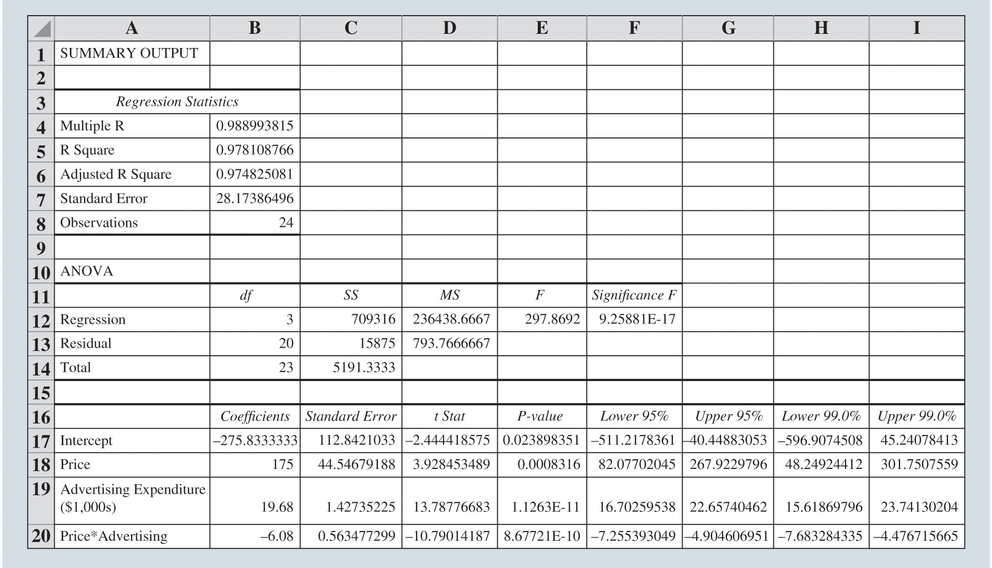
Modeling Nonlinear Relationships (Slide 16 of 16)
Figure 7.35: Excel Output for the Tyler Personal Care Linear Regression Model with Interaction
Notes:
The Excel output corresponding to the interaction model for the Tyler Personal Care example is provided in Figure 7.35.
The resulting estimated regression equation is Sales = –275.8333 + 175 Price + 19.68 Advertising – 6.08 Price × Advertising.

Slide 95
Model Fitting
Variable Selection Procedures
Overfitting

Slide 96
Model Fitting (Slide 1 of 11)
Variable Selection Procedures:
Special procedures are sometimes employed to select the independent variables to include in the regression model.
Iterative procedures: At each step of the procedure, a single independent variable is added or removed and the new model is evaluated. Iterative procedures include:
Backward elimination.
Forward selection.
Stepwise selection.
Best subsets procedure: Evaluates regression models involving different subsets of the independent variables.

Slide 97
Model Fitting (Slide 2 of 11)
Variable Selection Procedures (cont.):
Backward elimination procedure:
Begins with the regression model that includes all of the independent variables under consideration.
At each step, backward elimination considers the removal of an independent variable according to some criterion.
Stops when all independent variables in the model are significant at a specified level of significance.

Slide 98
Model Fitting (Slide 3 of 11)
Variable Selection Procedures (cont.):
Forward selection procedure:
Begins with none of the independent variables under consideration included in the regression model.
At each step, forward selection considers the addition of an independent variable according to some criterion.
Stops when there are no independent variables not currently in the model that meet the criterion for being added to the regression model.

Slide 99
Model Fitting (Slide 4 of 11)
Variable Selection Procedures (cont.):
Stepwise selection procedure:
Begins with none of the independent variables under consideration included in the regression model.
The analyst establishes both a criterion for allowing independent variables to enter the model and a criterion for allowing independent variables to remain in the model.
To initiate the procedure, the most significant independent variable is added to the empty model if its level of significance satisfies the entering threshold.

Slide 100
Model Fitting (Slide 5 of 11)
Variable Selection Procedures (cont.):
Stepwise selection procedure (cont.):
Each subsequent step involves two intermediate steps:
First, the remaining independent variables not in the current model are evaluated, and the most significant one is added to the model.
Then the independent variables in the current model are evaluated, and the least significant one is removed.
Stops when no independent variables not currently in the model have a level of significance for remaining in the regression model.

Slide 101
Model Fitting (Slide 6 of 11)
Variable Selection Procedures (cont.):
Best subsets procedure:
Simple linear regressions for each of the independent variables under consideration are generated, and then the multiple regressions with all combinations of two independent variables under consideration are generated, and so on.
Once a regression model has been generated for every possible subset of the independent variables under consideration, the entire collection of regression models can be compared and evaluated.

Slide 102
Model Fitting (Slide 7 of 11)
Overfitting:
Overfitting generally results from creating an overly complex model to explain idiosyncrasies in the sample data.
In regression analysis, this often results from the use of complex functional forms or independent variables that do not have meaningful relationships with the dependent variable.
If a model is overfit to the sample data, it will perform better on the sample data used to fit the model than it will on other data from the population.
Thus, an overfit model can be misleading about its predictive capability and its interpretation.

Slide 103
Model Fitting (Slide 8 of 11)
Overfitting (cont.):
How does one avoid overfitting a model?
Use only independent variables that you expect to have real and meaningful relationships with the dependent variable.
Use complex models, such as quadratic models and piecewise linear regression models, only when you have a reasonable expectation that such complexity provides a more accurate depiction of what you are modeling.
Do not let software dictate your model; use iterative modeling procedures, such as the stepwise and best-subsets procedures, only for guidance and not to generate your final model.

Slide 104
Model Fitting (Slide 9 of 11)
Overfitting (cont.):
How does one avoid overfitting a model? (cont.):
If you have access to a sufficient quantity of data, assess your model on data other than the sample data that were used to generate the model (this is referred to as cross-validation).
Three possible ways to execute cross-validation:
Holdout method.
k-fold cross-validation.
Leave-one-out cross-validation.

Slide 105
Model Fitting (Slide 10 of 11)
Overfitting (cont.):
Holdout method: The sample data are randomly divided into mutually exclusive and collectively exhaustive training and validation sets.
Training set: The data set used to build the candidate models that appear to make practical sense.
Validation set: The set of data used to compare model performances and ultimately select a model for predicting values of the dependent variable.
Notes:
For example:
We might randomly select half of the data for use in developing regression models.
We could use these data as our training set to estimate a model or a collection of models that appear to perform well.
Finally, we use the remaining half of the data as a validation set to assess and compare the models’ performances and ultimately select the model that minimizes some measure of overall error when applied to the validation set.

Slide 106
Model Fitting (Slide 11 of 11)
Overfitting (cont.):
k-fold cross-validation: The sample data are randomly divided into k equal-sized, mutually exclusive, and collectively exhaustive subsets called folds, and k iterations are executed.
Leave-one-out cross-validation: For a sample of n observations, an iteration consists of estimating the model on
observations and evaluating the model on the single observation that was omitted from the training data.
Notes:
For example:
We might randomly select half of the data for use in developing regression models.
We could use these data as our training set to estimate a model or a collection of models that appear to perform well.
Finally, we use the remaining half of the data as a validation set to assess and compare the models’ performances and ultimately select the model that minimizes some measure of overall error when applied to the validation set.

Slide 107
Big Data and Regression
Inference and Very Large Samples
Model Selection

Slide 108
Big Data and Regression (Slide 1 of 6)
Inference and Very Large Samples:
Virtually all relationships between independent variables and the dependent variable will be statistically significant if the sample is sufficiently large.
That is, if the sample size is very large, there will be little difference in the
values generated by different random samples.

Slide 109
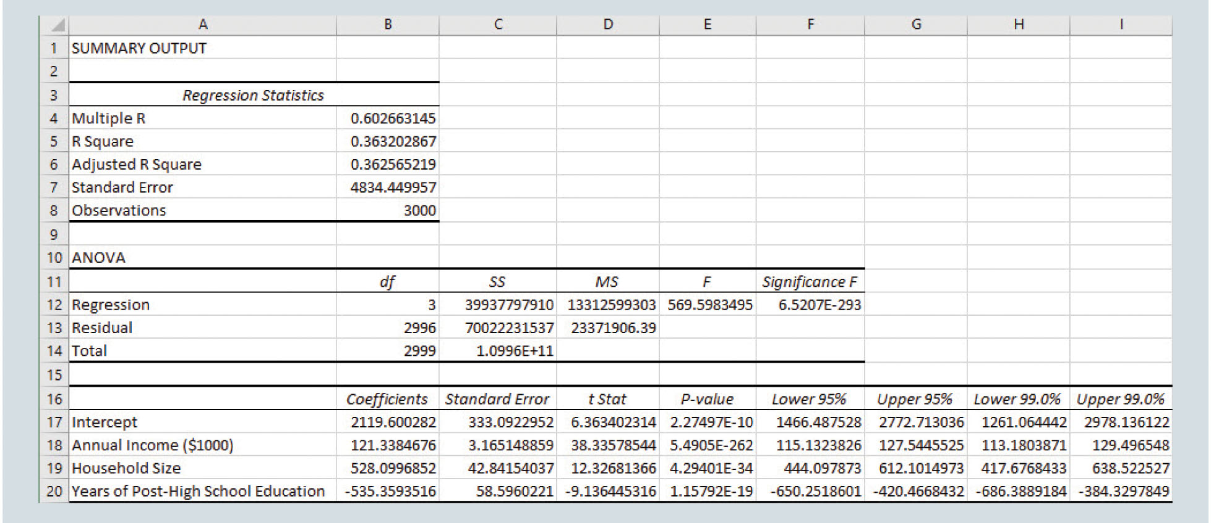
Big Data and Regression (Slide 2 of 6)
Figure 7.36: Excel Regression Output for Credit Card Company Example
Notes:
Figure 7.36 provides Excel output for the multiple regression model based on the 3,000 observations in the training set.
The model has a coefficient of determination of 0.3632 (see cell B5 in Figure 7.36), indicating that this model explains approximately 36% of the variation in credit card charges accrued by the customers in the sample over the past year.
The p value for each test of the individual regression parameters is also very small (see cells E18 through E20), indicating that for each independent variable we can reject the hypothesis of no relationship with the dependent variable.
The estimated slopes associated with the dependent variables are all highly significant. The model estimates the following:
For a fixed number of household members and number of years of post-high school education, accrued credit card charges increase by $121.34 when a customer’s annual household income increases by $1,000. This is shown in cell B18 of Figure 7.36.
For a fixed annual household income and number of years of post-high school education, accrued credit card charges increase by $528.10 when a customer’s household increases by one member. This is shown in cell B19 of Figure 7.36.
For a fixed annual household income and number of household members, accrued credit card charges decrease by $535.36 when a customer’s number of years of post-high school education increases by one year. This is shown in cell B20 of Figure 7.36.

Slide 110
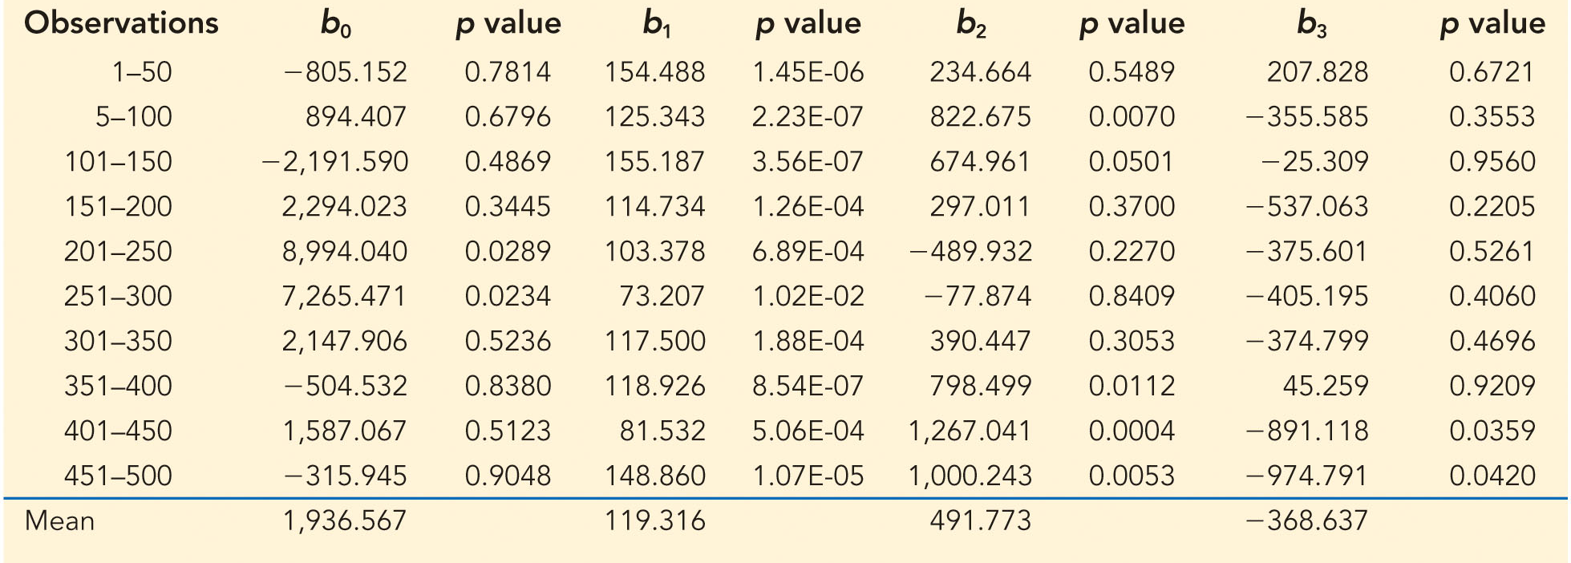
Big Data and Regression (Slide 3 of 6)
Table 7.4: Regression Parameter Estimates and the Corresponding p values for 10 Multiple Regression Models, Each Estimated on 50 Observations from the LargeCredit Data
Notes:
Table 7.4 provides the regression parameter estimates and the corresponding p values for multiple regression models estimated on the first 50 observations, the second 50 observations, and so on for the LargeCredit data.
Note that, even though the means of the parameter estimates for the regressions based on 50 observations are similar to the parameter estimates based on the full sample of 5,000 observations, the individual values of the estimated regression parameters in the regressions based on 50 observations show a great deal of variation.

Slide 111

Big Data and Regression (Slide 4 of 6)
Figure 7.37: Excel Regression Output for Credit Card Company Example after Adding Number of Hours per Week Spent Watching Television
Notes:
The data analyst notes in the results in Figure 7.36 that the original regression model fails to explain almost 65% of the variation in credit card charges accrued by the customers in the data set.
The analyst runs the new multiple regression and achieves the results shown in Figure 7.37.

Slide 112
Big Data and Regression (Slide 5 of 6)
Model Selection:
When dealing with large samples, it is often more difficult to discern the most appropriate model.
If developing a regression model for explanatory purposes, the practical significance of the estimated regression coefficients should be considered when interpreting the model and considering which variables to keep in the model.
If developing a regression model to make future predictions, the selection of the independent variables to include in the regression model should be based on the predictive accuracy on observations that have not been used to train the model.

Slide 113

Big Data and Regression (Slide 6 of 6)
Figure 7.38: Predictive Accuracy on LargeCredit Validation Set
Notes:
For the example of a credit card company with a data set of customer records containing information on the customer’s annual household income, number of years of post-high school education, number of members of the customer’s household, and the credit card charges accrued, the company is considering two models to predict the annual credit card charges for its new applicants.
Model A, summarized in Figure 7.36
Model B, summarized in Figure 7.37
Figure 7.38 compares these models based on their predictive accuracy on the 2,000 observations in the validation set.

Slide 114
Prediction with Regression

Slide 115


Prediction with Regression (Slide 1 of 2)
In addition to the point estimate, there are two types of interval estimates associated with the regression equation:
A confidence interval is an interval estimate of the mean y value given values of the independent variables.
A prediction interval is an interval estimate of an individual y value given values of the independent variables.

Slide 116

Prediction with Regression (Slide 2 of 2)
Table 7.5: Predicted Values and 95% Confidence Intervals and Prediction Intervals for 10 New Butler Trucking Routes
Notes:
In the Butler Trucking example, for all 105-mile routes with 3 deliveries, a 95% confidence interval on the mean travel time is 9.25 ± 0.193. That is, we are 95% confident that the true population mean travel time for 105-mile routes with 3 deliveries is between 9.06 and 9.44 hours.

